Slide 1
Machine learning aided Android malware detection
Nikola Milosevic
Twitter: @dreadknight011
Email: nikola.milosevic@owasp.org

Slide 2
About me
Founder of OWASP Serbia – 2012
OWASP Manchester chapter leader – 2015
OWASP Seraphiomdroid project leader – 2013
Soon PhD computer science (University of Manchester)
Working at Manchester institute for innovation research (Manchester Business School)
www.inspiratron.org

Slide 3
What the talk is about
Two machine learning methods for static Android malware detection
Permission-based
Source code-based
Android security model
Malware detection
Machine learning (NLP)

Slide 4
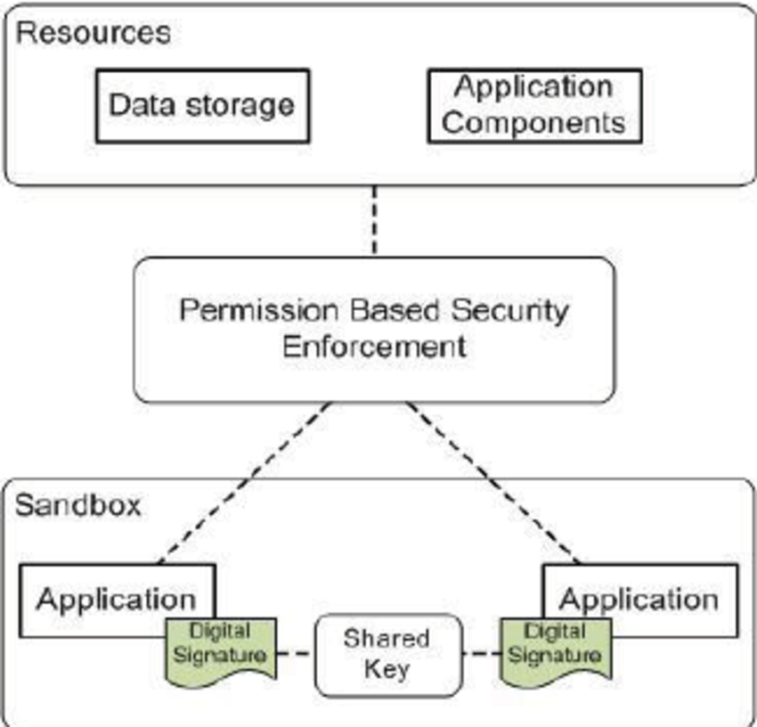
Android security model
Sandbox
User have to grant
permissions to apps
Users usually want
app, don’t care much
about security

Slide 5
Why Android malware
82% Android market share 2016
68% of mobile users use Android
In 2015 there were 5000 new Android malware samples daily
Can be distributed
over Google Play

Slide 6
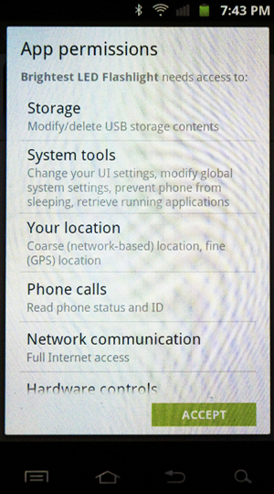
Android malware
Target regular users (non-rooted)
Usual uses:
Steal personal data including, not
limited to
Contacts
Banking details
Secrets (files)
Mine crypto-currency
Use for DDoS botnets
Ransom (blackmail)
Destroy device

Slide 7
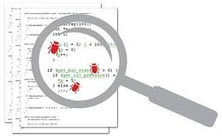
Malware detection traditionally
Static
reviews the source code and binaries in order to find suspicious patterns
Dynamic
involves the execution of the analysed software in an isolated environment while monitoring and tracing its behaviour

Slide 8
Static analysis approaches
Traditionally – signatures
Patterns in:
Binary file
API calls
Op-codes
Methods:
Manual analysis
Pattern detection
Machine learning

Slide 9
Behavioural analysis approaches
Executing in the sandbox
Monitoring battery, op-codes, API calls, etc.
Huge amount of malware -> move towards behavioural analysis
Requires root access on Android

Slide 10
Our approaches
STATIC ONLY
2 machine learning approaches
Permission-based approach - baseline
Code-based approach
Classification
Clustering (boot-strapping)

Slide 11
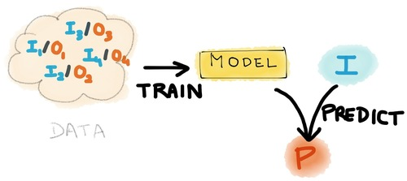
Machine learning intro
Generates model from data
Supervised and
unsupervised
Usually uses probability,
statistics and other math
Classification
Clustering

Slide 12
Permission-based approach
Combination of permissions as ML input
Trained on M0DROID dataset
200 good apk files
200 malicious apk files

Slide 13
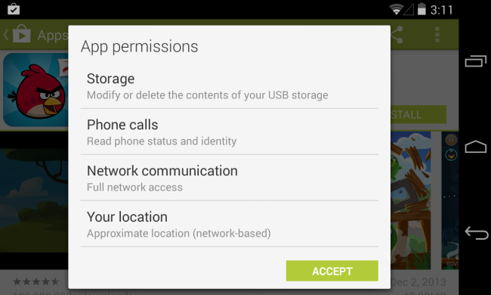
Permission-based approach
Idea: Learn the malicious patterns of permissions
Limitation: Usually not enough!

Slide 14
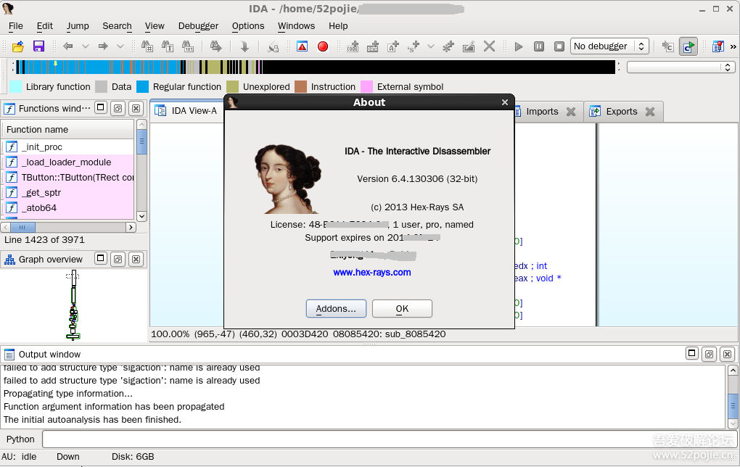
Code-based methodology
Decompiled code used for training
Idea: Teach machine to analyse code as human analyst

Slide 15
Code-based methodology
Used M0Droid dataset
Could not decompile 32 (10 non-malicious and 22 malicious)
Idea: Code ~ text/natural language
If we can teach machine to analyse and classify text, why can’t we teach it to do same with code?

Slide 16
Bag-of-Words
Bag of words approach on code
Naïve assumption (order does not matter)
Often used in NLP (i.e. sentiment analysis, language detection, etc.)

Slide 17
Code-based methodology (diagram)

Slide 18
Algorithms used
Classification
SVM, Naïve Bayes, Decision trees, Random forests, JRIP, Logistic regression
Ensembles of 3 algorithms with voting
Clustering
SimpleKMeans, EM, Fathest first

Slide 19
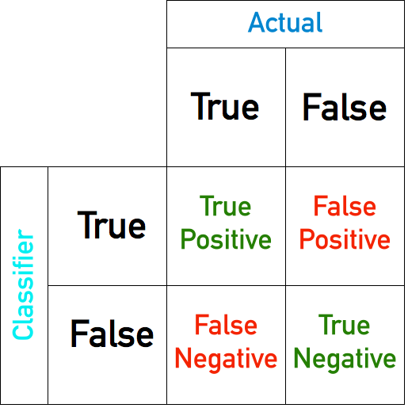
Evaluation
$Pecision= \frac{tp}{tp+fp}$
$Recall= \frac{tp}{tp+fn}$
$F1= \frac{2∗Precision∗Recall}{(Precision +Recall)}$

Slide 20
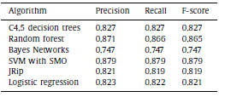
Results – Permission based classification

Slide 21
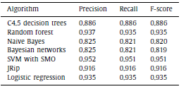
Results – Source code based classification

Slide 22
Results - Clustering
Permission based
Source code-based

Slide 23
Clustering - limitation

Slide 24
Use cases
Permission-based classification
Fast
OK performance (85%-89%)
Can execute on phone
Part of OWASP Seraphimdroid permission scanner
Source code-based classification
Computationally too expensive for the phone
State-of-the-art performance (95+%)

Slide 25
Use cases - clustering
Worse performance than classification
Bootstrapping use
Creation of larger datasets
Not useful for malware detection
Low performance
Clusters overlap (Especially permission based)

Slide 26
Conclusion
Source code analysis can be done successfully by machine
Malware detection scores are high
Generalizable approach (new malwares will be detected, no need for signatures)
Interdisciplinary security research can be useful (NLP in code analysis)

Slide 27
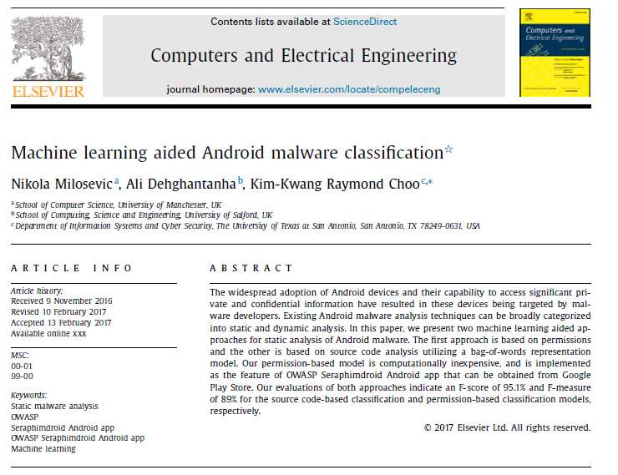

Slide 28
OWASP Seraphimdroid
Permission scanner
Application lock
Service lock
Settings check
USSD scanner
SMS & MMS phishing prevention
Geo-fencing
Knowledge base

Slide 29
Thank you for listening!
nikola.milosevic@manchester.ac.uk
Twitter: @dreadknight011
Web: www.inspiratron.org

