Slide 1
Intro to Red Team
By
Sridhar V

Slide 2
What is Red Teaming
Red teaming is a strategy used in cybersecurity, military, and business to test the effectiveness of an organization's defenses and strategies by simulating adversarial attacks or competitive challenges. Experts, known as the "red team," mimic the tactics of potential attackers to identify vulnerabilities and weaknesses, providing objective analysis and realistic scenarios. The insights gained from these exercises are used to improve the organization's defenses, strategies, and protocols, enhancing overall security and resilience.

Slide 3
Difference between Penetration Testing and Red Teaming
Red Teaming
Scope:
Encompasses a broader scope, including network security, physical security, social engineering, and operational processes. It aims to simulate a real-world attack to evaluate overall defense mechanisms.
Approach:
Mimics a persistent and adaptive adversary, often working over an extended period. It employs a wide range of tactics, techniques, and procedures to breach defenses.
Objectives:
Aims to test the organization's overall security posture, including detection and response capabilities. The goal is to improve resilience against sophisticated and persistent threats.
Penetration testing
Scope:
Focuses on specific targets, such as a particular network, application, or system, to identify and exploit vulnerabilities within that defined scope.
Approach:
Typically conducted in a shorter, more defined timeframe with a structured methodology. It follows a set of predefined tests to find and exploit vulnerabilities.
Objectives:
Seeks to identify and report specific vulnerabilities so they can be fixed. The focus is on finding and exploiting weaknesses to prevent potential attacks.

Slide 4
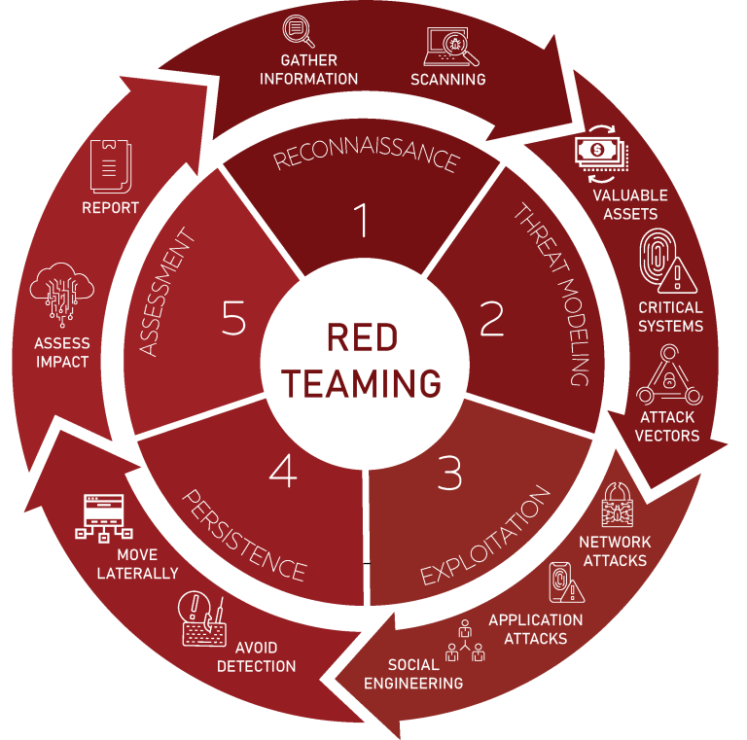
Red Team Phases

Slide 5
Useful Tools for Red Team Assessment
OSINT And Darkweb Analysis :
Spiderfoot
Intelligenx
Shodan
Hunter.io
DNSDumpster
DorkGPT
Subdomain Finder
Darkweb forums
Darkweb monitoring service

Slide 6
Useful Tools for Red Team Assessment
Social Engineering - Phishing :
Godaddy or any domain register service
Cloud Service like aws
Mail server
C2 server like gophish
Mail content
Phishing page

Slide 7
Useful Tools for Red Team Assessment
Physical Breach :
Dress Code
Wifi pineapple
Bad USB
Flipper Zero
Road map

Slide 8
Useful Tools for Red Team Assessment
Internal Network :
Advanced IP Scanner
Nmap
Bloodhound
Sharphound
Impacket
Kali tools

Slide 9
OSINT
Identify key individuals and organizational structure through social media, public directories, and professional networks like LinkedIn.
Discover technical information such as IP addresses, domain names, subdomains, network infrastructure, and software versions that are publicly exposed.
Analyze the digital footprint of the target, including past breaches, public repositories (like GitHub), or even misconfigured cloud storage.
Harvest credentials from public breaches, leaked databases, or other exposed sources to facilitate later attack phases.

Slide 10
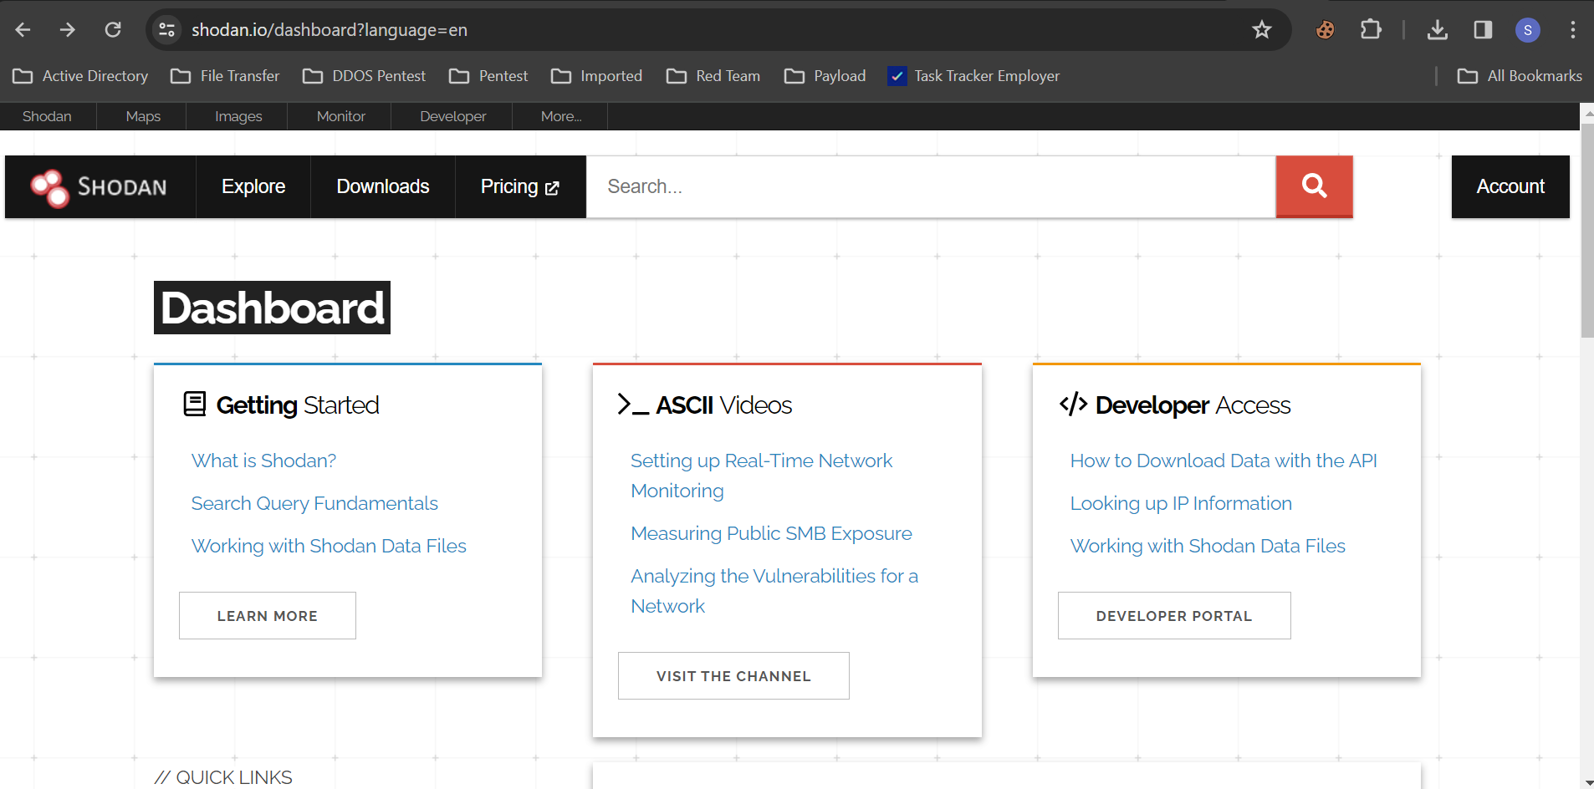
Shodan
Shodan is a search engine specifically designed to find and index information about internet-connected devices. It's often referred to as the "search engine for hackers" due to its ability to locate various types of devices connected to the internet, including servers, routers, webcams, printers, and even industrial control systems.

Slide 11
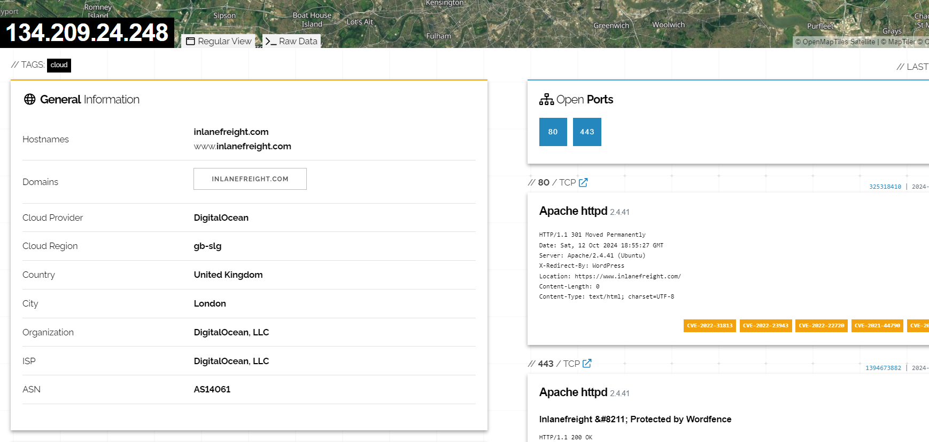
Ping the domain to get the IP
Search the IP in shodan to get a lot of information

Slide 12
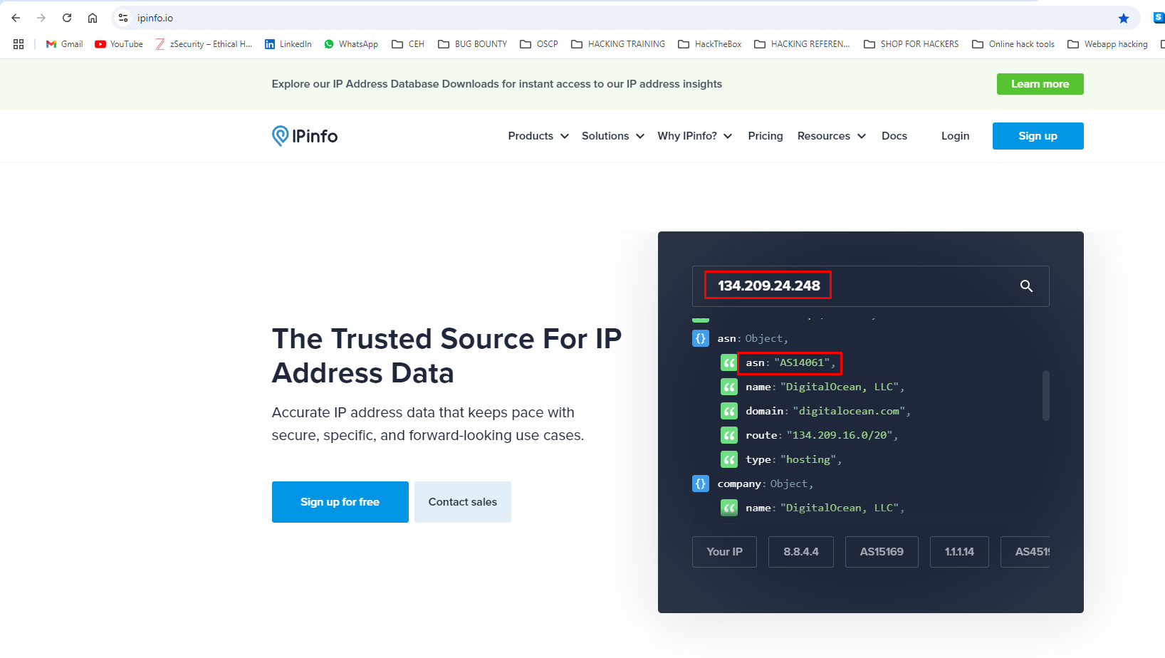
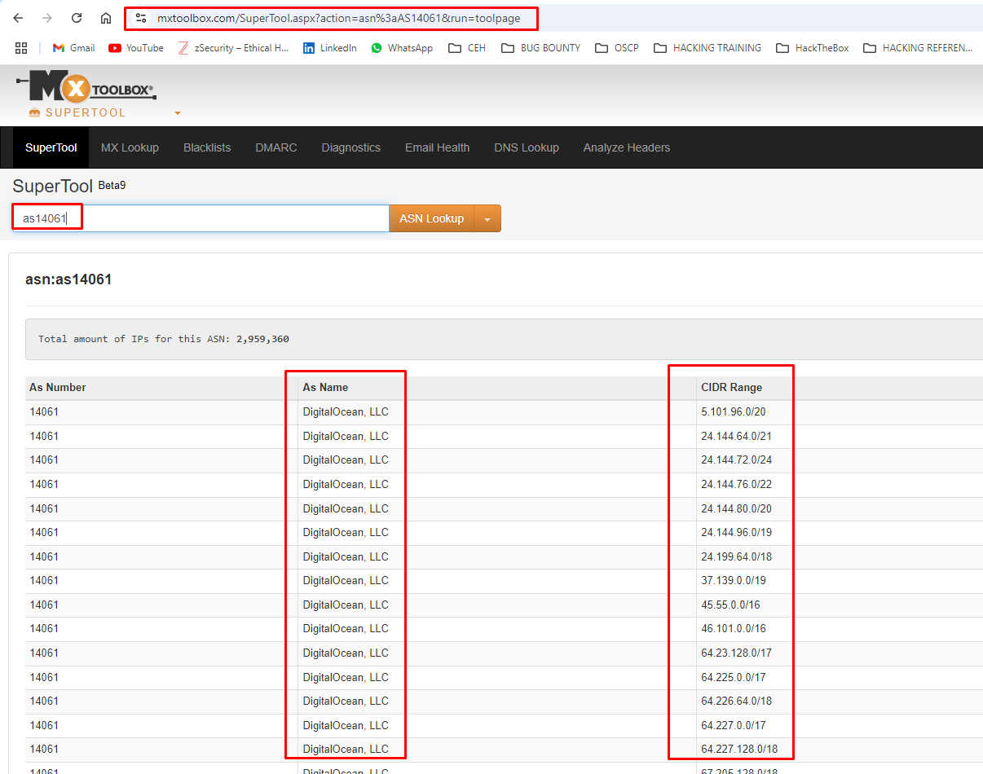
ASN Enumeration
This is the Autonomous System Number (ASN). This number is unique and is made publicly available so routing information can be exchanged with other systems. This is done with specific IP prefixes, which we can use to find out the netblocks (public ASNs).

Slide 13
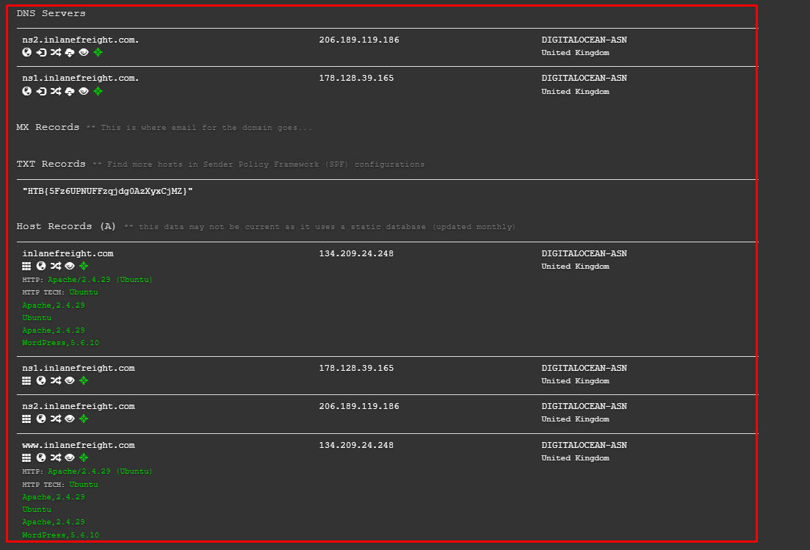
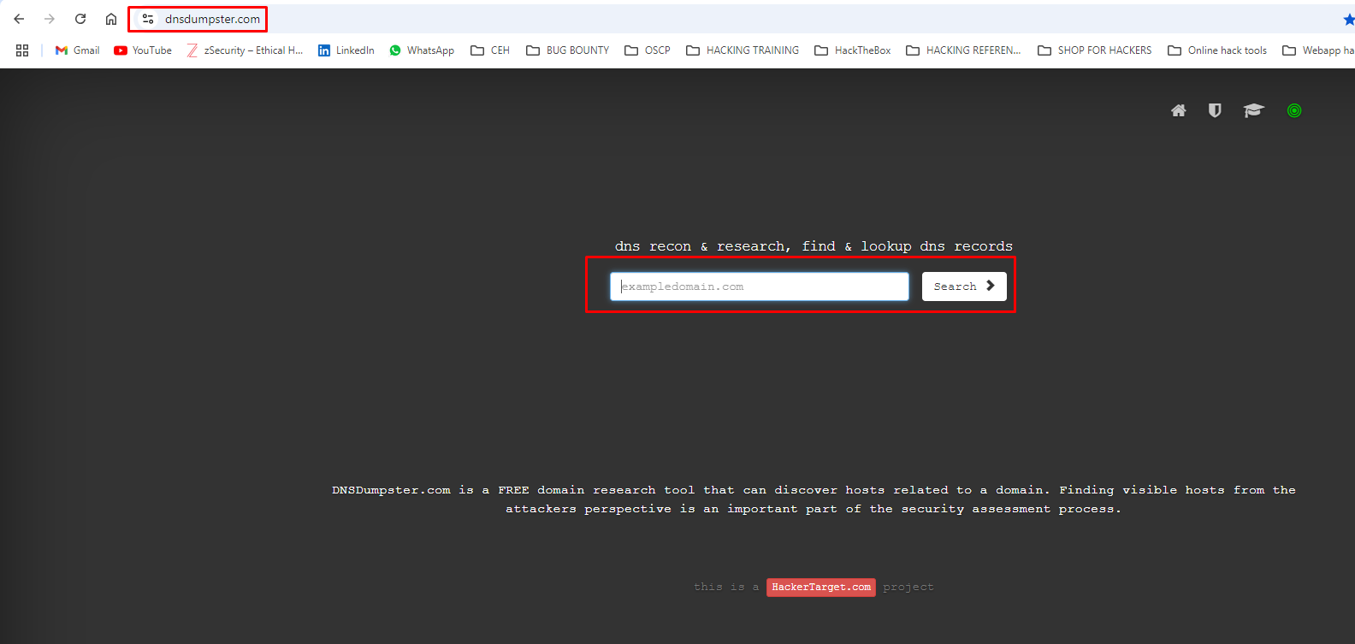
DNSDumpster
DNSDumpster is an online tool that provides DNS (Domain Name System) reconnaissance and enumeration capabilities. It allows users to gather information about a particular domain by querying DNS records and presenting the results in an organized and easy-to-understand format.
Visit this site https://dnsdumpster.com/

Slide 14
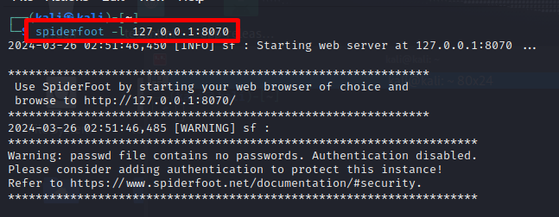
Spiderfoot
SpiderFoot is an open-source intelligence (OSINT) automation tool used for reconnaissance and footprinting purposes in cybersecurity. It is designed to automate the process of gathering information about various entities (such as IP addresses, domain names, email addresses, etc.) from different data sources on the internet.
We need to run the spiderfoot using the following command “spiderfoot -l [localhost] [port]”

Slide 15
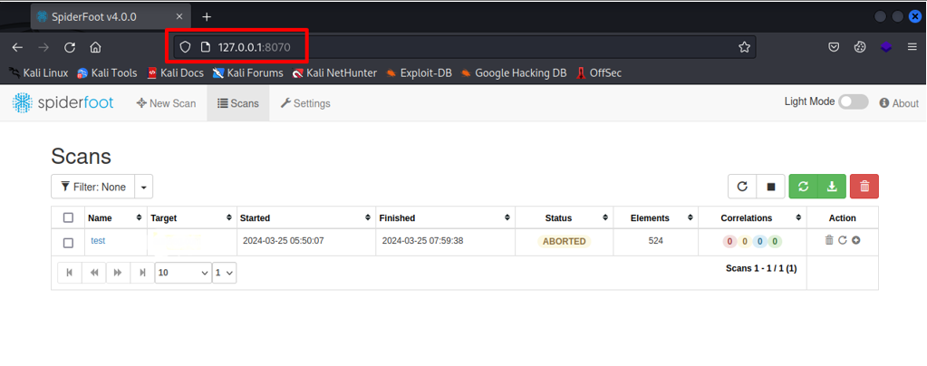
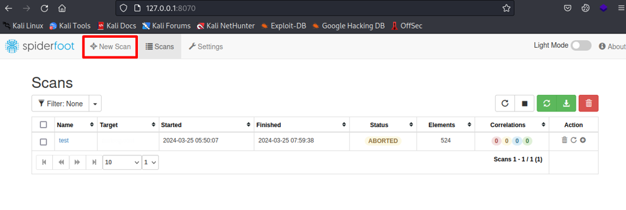
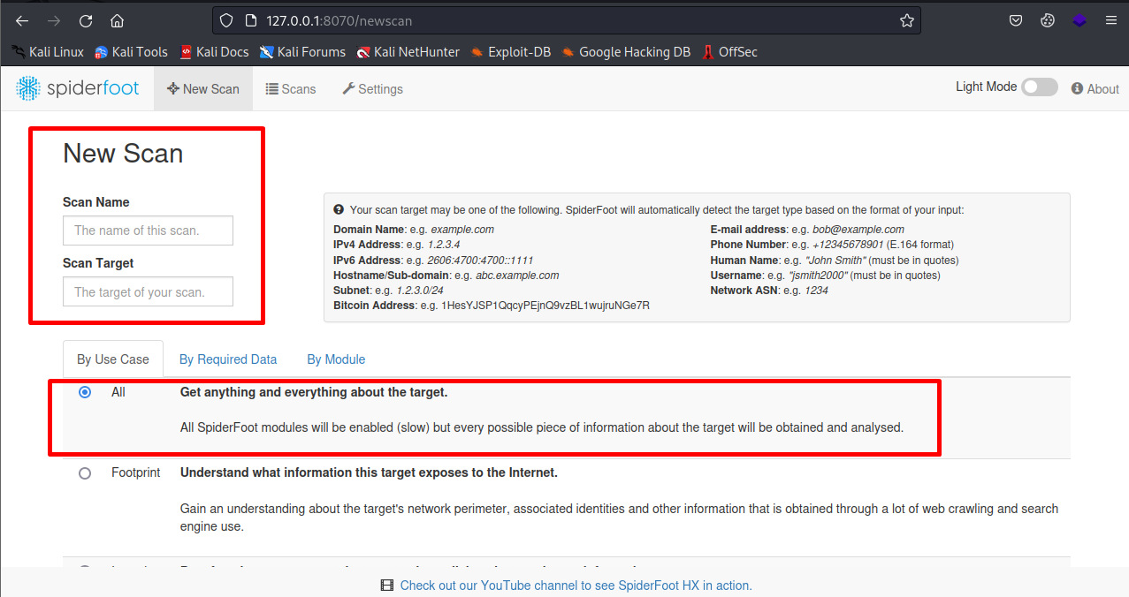
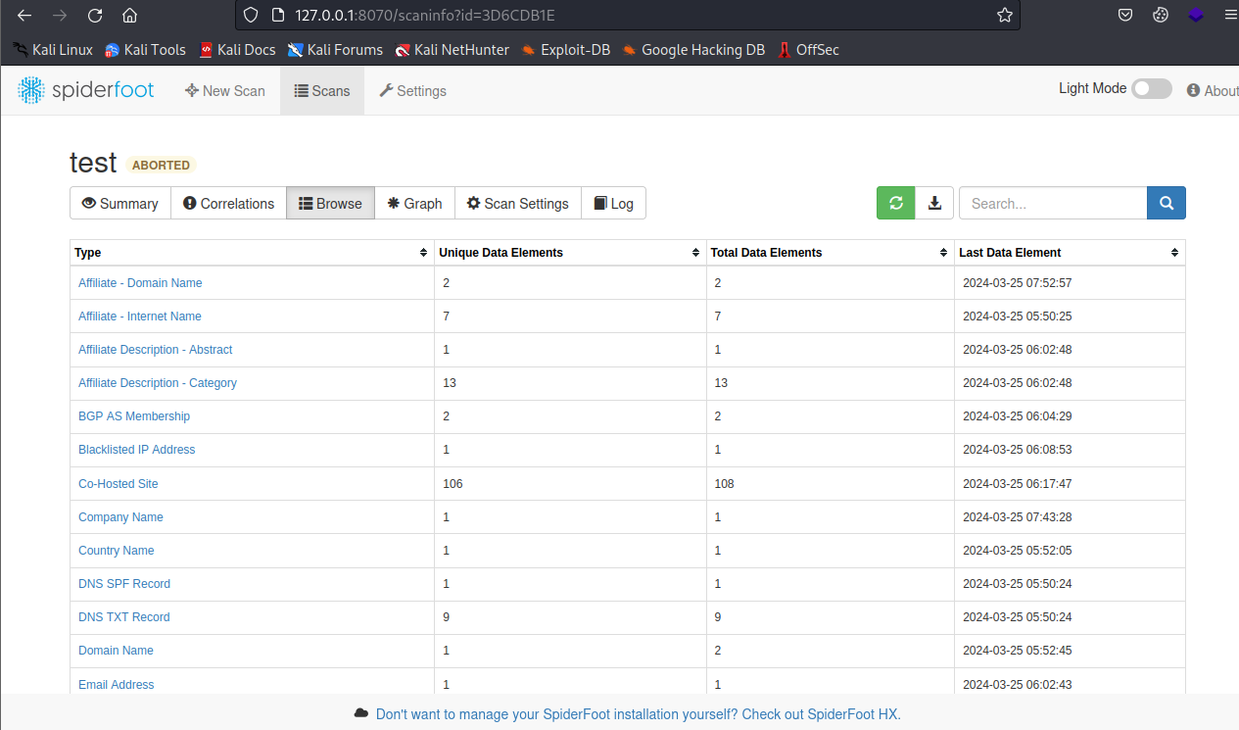
Open the 127.0.0.1:8070 in the browser to access spiderfoot
Click New Scan icon to initiate a new scan
Set the name and target and select the enumeration type then save and initate the scan
After the scan is initiated in this dashboard you can find the enumerated data

Slide 16
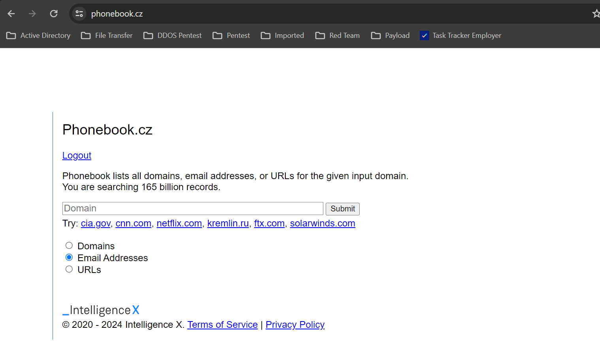
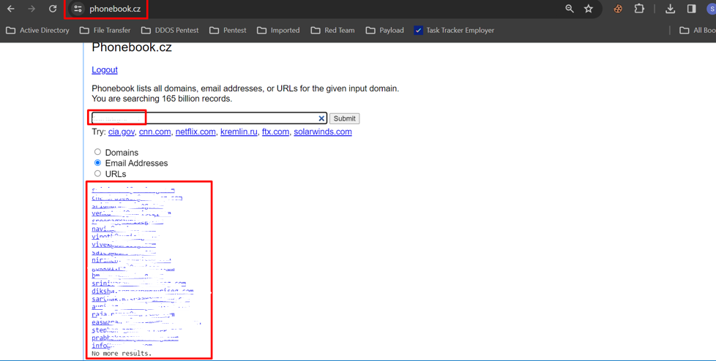
Email ID Enumeration
We can use the following tools to gather Email IDs:
Phonebook
Hunter
Phonebook from IntelligenceX
You can use Intelligence X to perform any kind of open-source intelligence. We deliver fast, high-quality results and make the deepest parts of the internet accessible with a few clicks. Intelligence X searches billions of selectors in a matter of milliseconds. Combined with our data archive this is a powerful new tool.
Visit this site https://phonebook.cz/

Slide 17
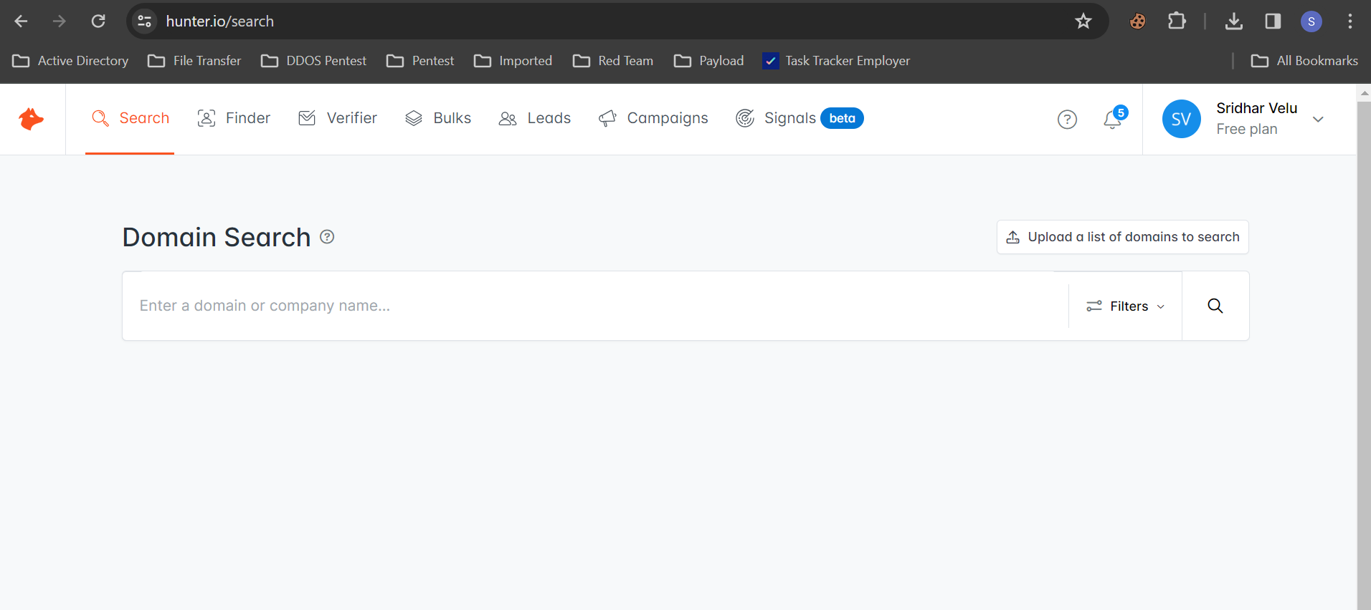
Hunter
Hunter.io is an online platform and tool commonly used for email address search and verification. It provides various services related to email outreach and lead generation for businesses and professionals.
Visit this site https://hunter.io/search

Slide 18
Dark Web Analysis
Identifying stolen credentials from data breaches or leaks that might be traded on underground marketplaces or forums.
Discovering mentions of the organization in discussions about potential exploits, vulnerabilities, or breaches by cybercriminals.
Locating sensitive data leaks, such as intellectual property, confidential business information, or client data that has been exposed on dark web platforms.
Monitoring threat actor activity to gain insight into potential attack plans, techniques, or tools targeting the organization.
Evaluating dark web marketplaces for any products or services, like exploits or malware, aimed at the organization or its industry sector.

Slide 19
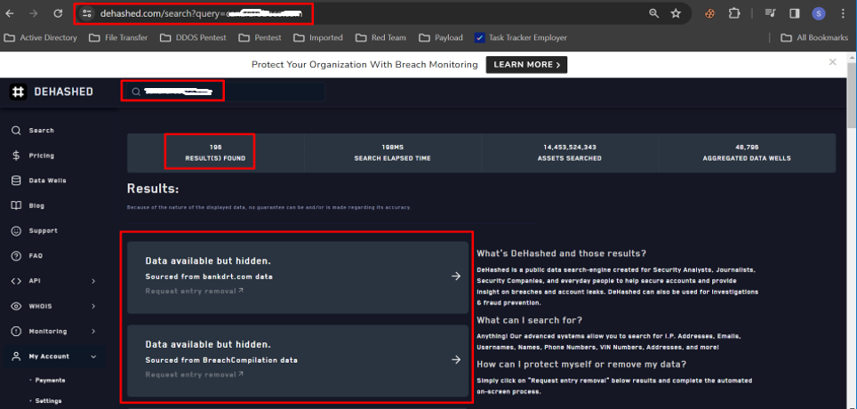
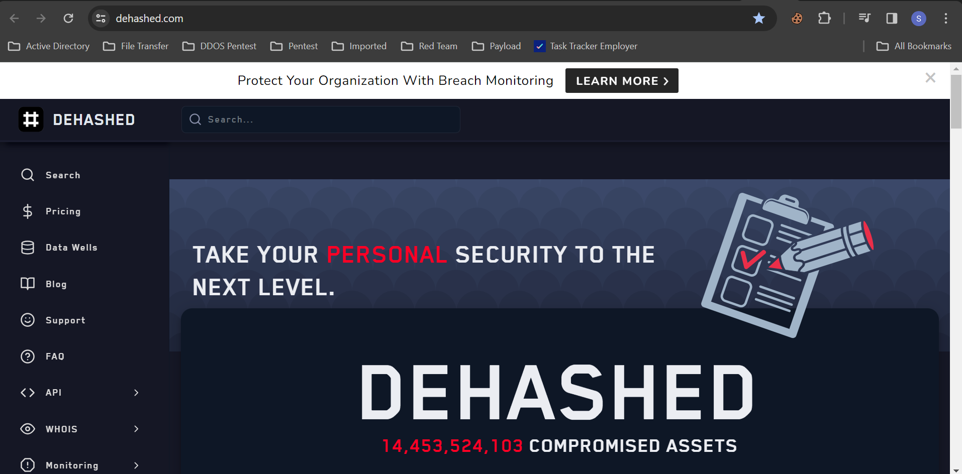
Leaked Data
We can use the following tools to gather leaked data:
Dehashed
Leakpeek
Identity Guard
Google Dork
Dehashed
DeHashed is an online service and data breach repository that aggregates and indexes data from various breaches and leaks across the internet. It provides users with a platform to search and access breached data for research, security analysis, and personal awareness.
Visit this site https://dehashed.com/

Slide 20
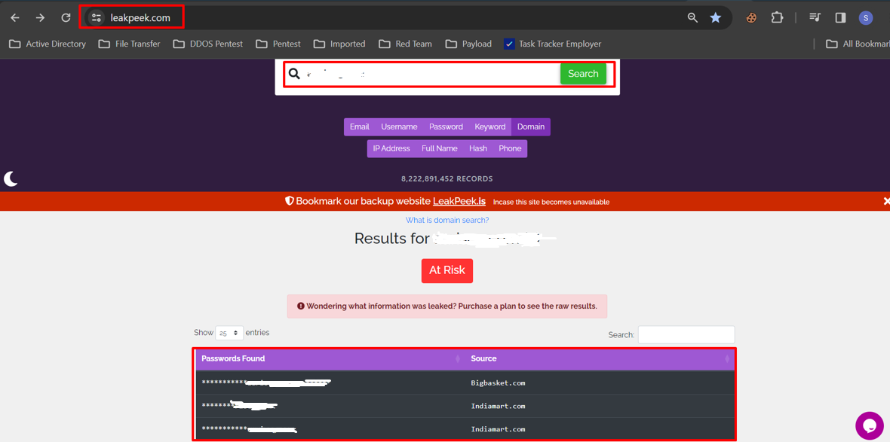
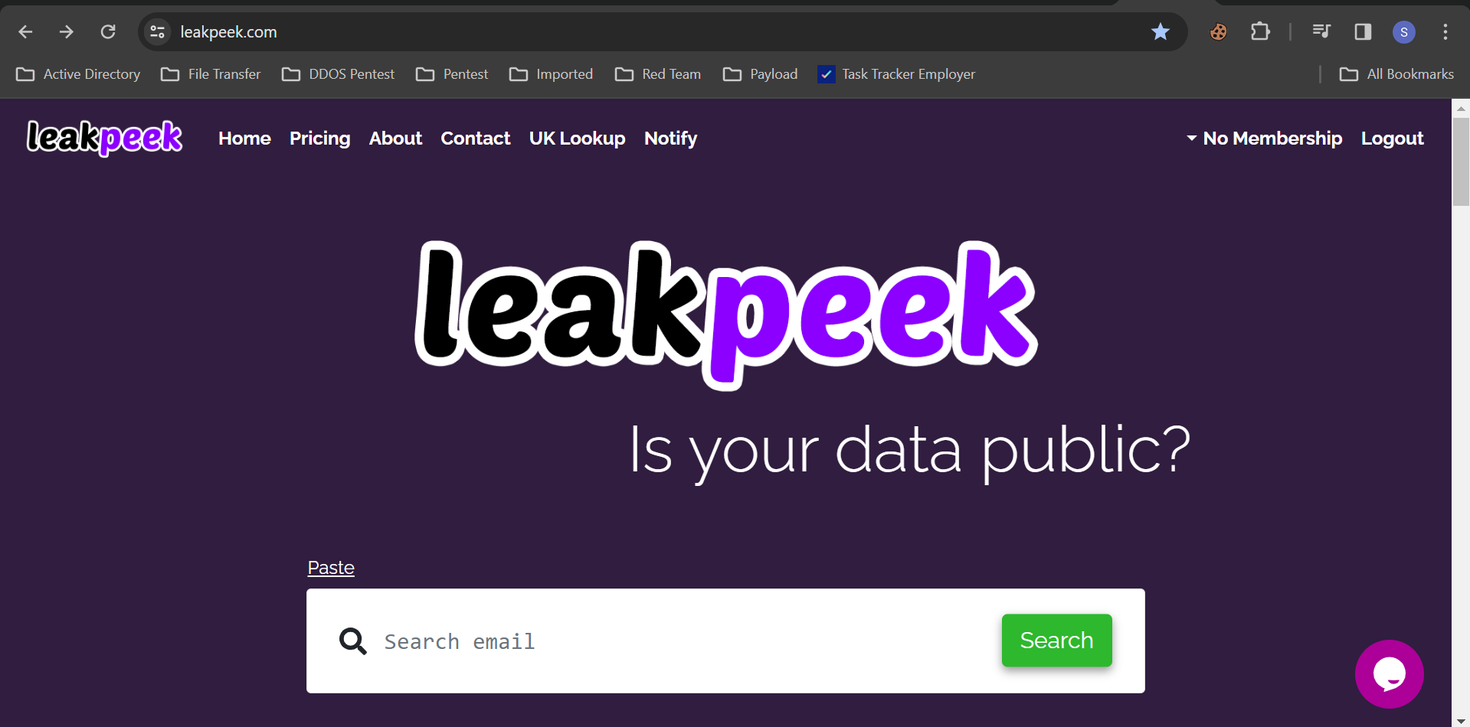
Leakpeek
LeakPeek indexes information from websites that have been hacked and had their database leaked. We allow our users to search for emails or usernames so they can find out if their information has been leaked. After a search we display all available information from that hacked site. All related data points found in the breach is made available to the user so they can update their information and keep it out of the hands of hackers and cyber criminals.
Visit this site https://leakpeek.com/

Slide 21
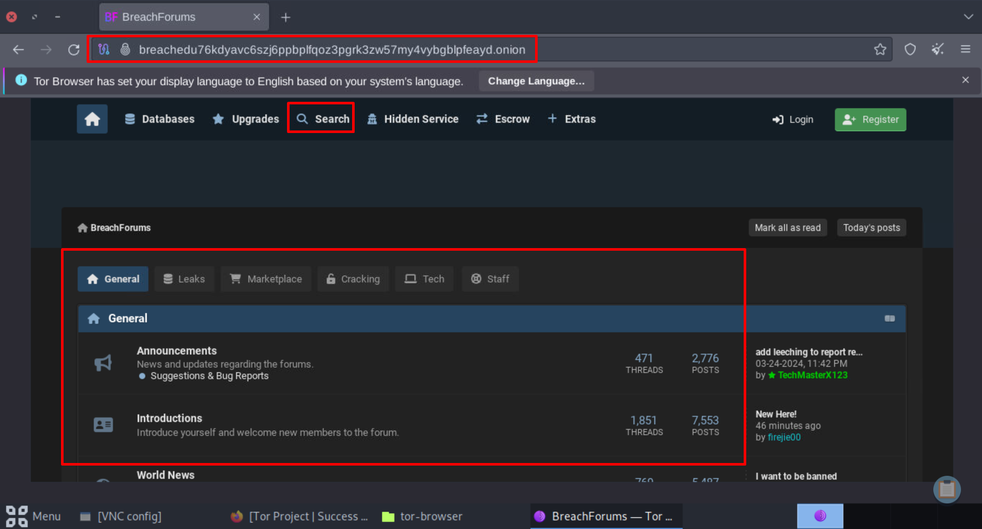
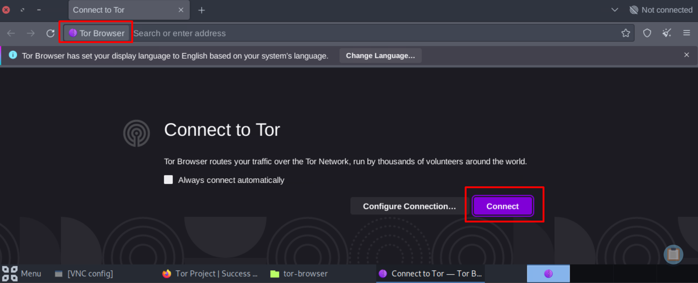
DarkWeb Forum
A "breach forum" typically refers to an online platform or community where individuals share and discuss information related to data breaches, cybersecurity incidents, hacking techniques, and stolen data. These forums can be both public and private, and they often serve as marketplaces for buying, selling, and trading stolen data such as usernames, passwords, credit card numbers, and personal information.
In breach forums, cybercriminals may advertise stolen data for sale, offer hacking services, exchange tips and tricks for exploiting vulnerabilities, and discuss techniques for evading detection by law enforcement and security professionals. These forums can be accessed through the dark web or through private channels on encrypted messaging platforms.

Slide 22
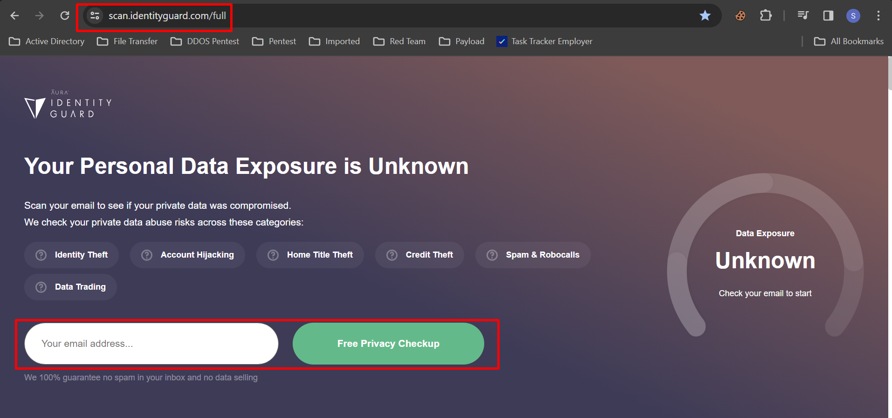
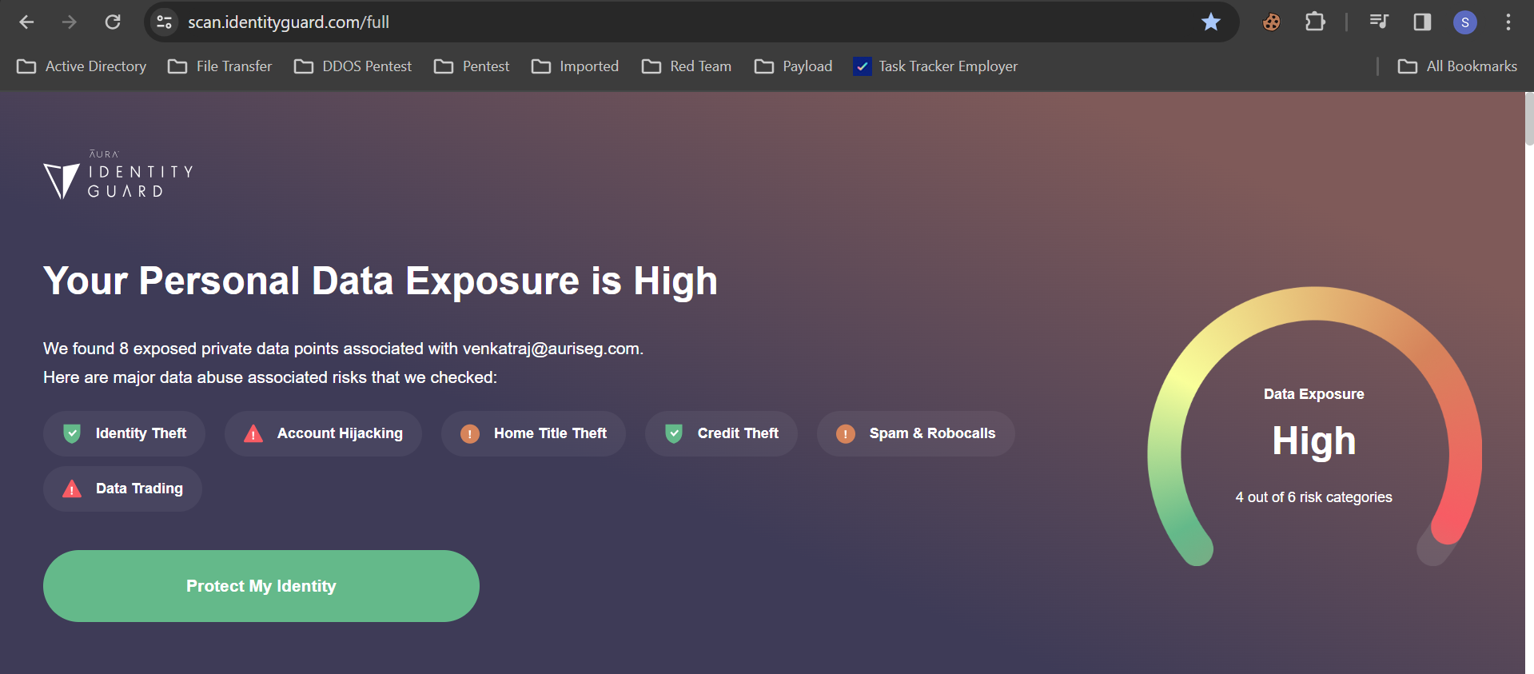
Identity Guard
IdentityGuard is a comprehensive identity theft protection service that helps individuals safeguard their personal and financial information from various forms of identity theft and fraud. It offers a range of features and tools designed to monitor, detect, and respond to potential threats to one's identity.
Visit this site https://scan.identityguard.com/full

Slide 23
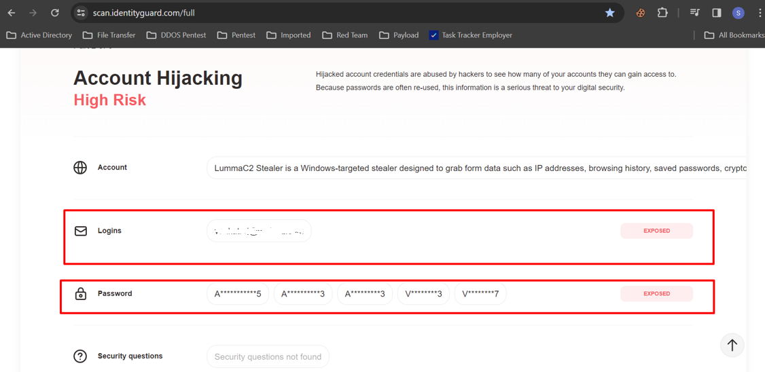
It will show the risk rating and all the leaked information.

Slide 24
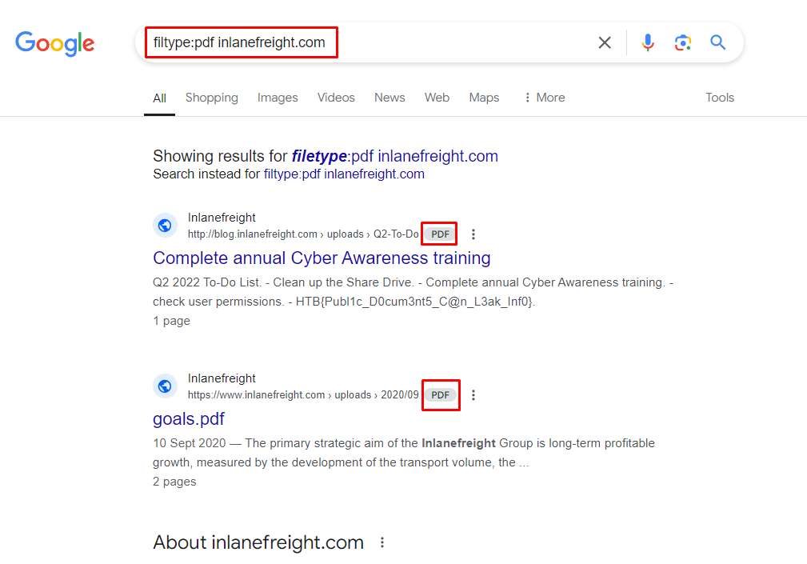
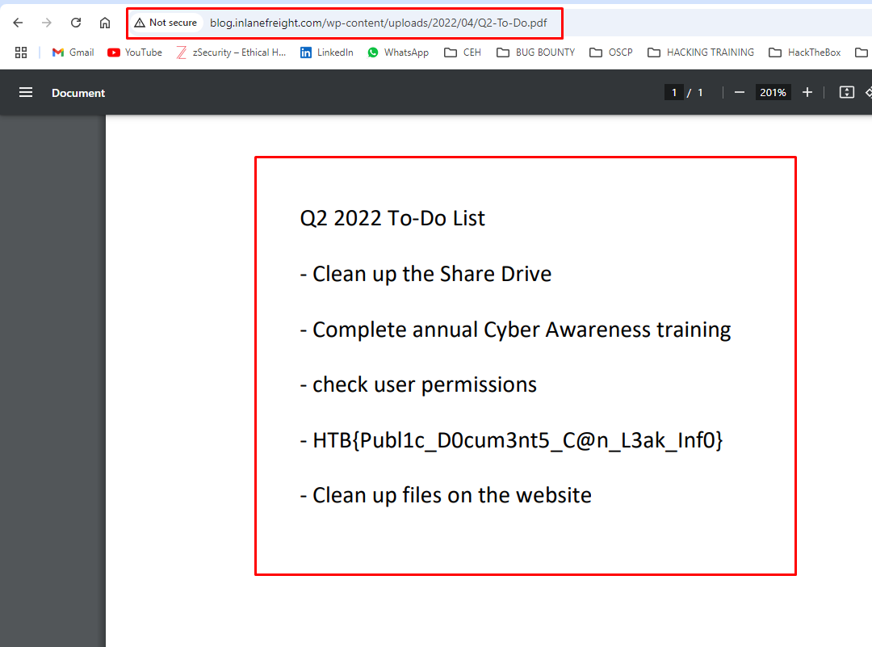
Google Dork
"Google dork," also known as "Google hacking," refers to the practice of using advanced search operators and techniques to refine and narrow down Google search results, often to uncover specific information that is not typically visible through conventional searches. Google dorks are search queries that exploit Google's search syntax to reveal sensitive or hidden information that may not be readily accessible.
Visit this site https://dorkgpt.com/

Slide 25
Data Exfiltration
Data exfiltration using a Bad USB is a technique that leverages maliciously modified USB devices to extract sensitive information from a target system or network.
A malicious USB device disguised as a regular peripheral, used to execute automated commands or payloads when plugged into a target machine.
Attacker gains physical access, and the Bad USB deploys malicious scripts (e.g., PowerShell) to capture sensitive data from the system.
Network Exfiltration: Data sent over HTTP/HTTPS or FTP to an external server.
Physical Exfiltration: Data stored on the USB for manual extraction. Physical Exfiltration: Data stored on the USB for manual extraction.

Slide 26
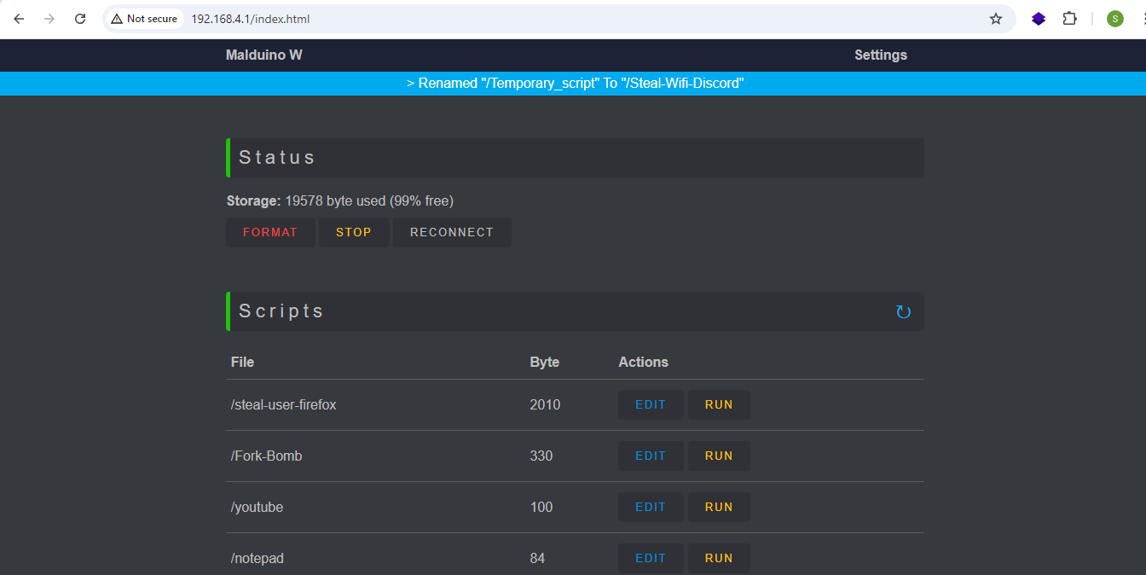
Once the Bad USB is connected to any port, it will establish a Wi-Fi network. We can connect to that Wi-Fi SSID and visit http://192.168.4.1 in the browser to access the C2 server of the Bad USB.

Slide 27
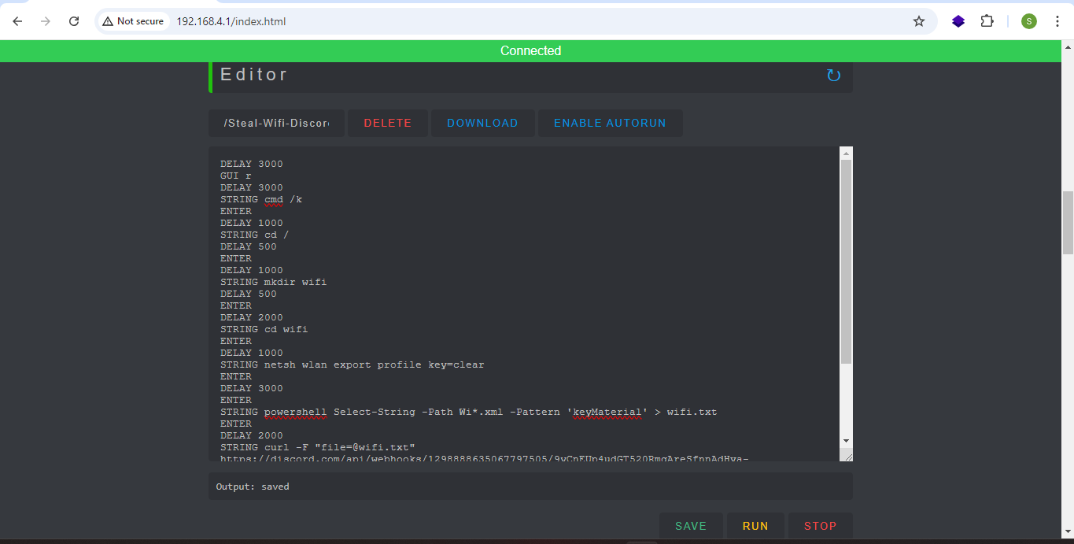
In the editor tab, you can edit the Ducky script and save it. You can then run the script remotely where the Bad USB is connected, or we can enable 'ENABLE AUTORUN' to run the script automatically when the USB is connected to any device.

Slide 28
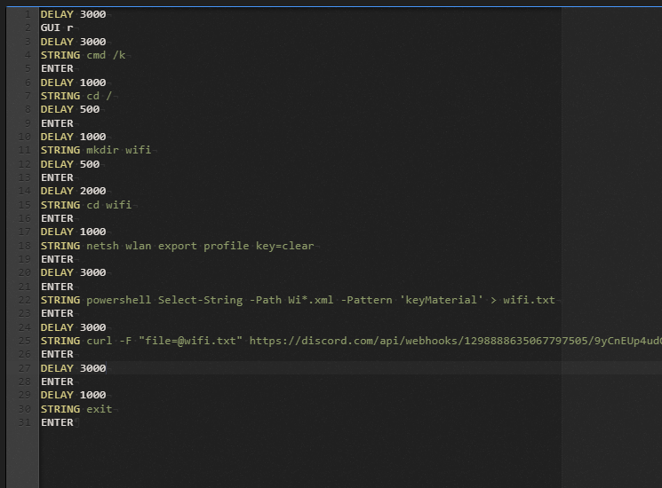
This script automates a series of actions using a Bad USB device. It opens the command prompt, creates a directory called "wifi", and exports Wi-Fi profiles with clear-text passwords using netsh wlan export. It then uses PowerShell to extract the Wi-Fi passwords (keyMaterial) from the exported XML files into a wifi.txt file. Finally, it uploads the wifi.txt file containing the passwords to a Discord webhook using curl, before closing the command prompt.

Slide 29
We got the Wifi passwords in the discord server via webhook

Slide 30
Active Directory Attacks
Red teamers gather information about the AD environment using tools like BloodHound, PowerView, and ADRecon to map users, groups, and trust relationships.
They identify critical assets (e.g., Domain Controllers) and high-privileged accounts (e.g., Domain Admins).
Once elevated access is gained, red teamers use techniques like Pass-the-Hash, Pass-the-Ticket, or DC Sync to move laterally across the network.
Red teamers establish persistence using Golden Tickets (forged Kerberos tickets granting indefinite admin access) or Silver Tickets (for targeting specific services).
Sensitive data can be exfiltrated from the AD environment, including password dumps, user account information, and configuration data.

Slide 31
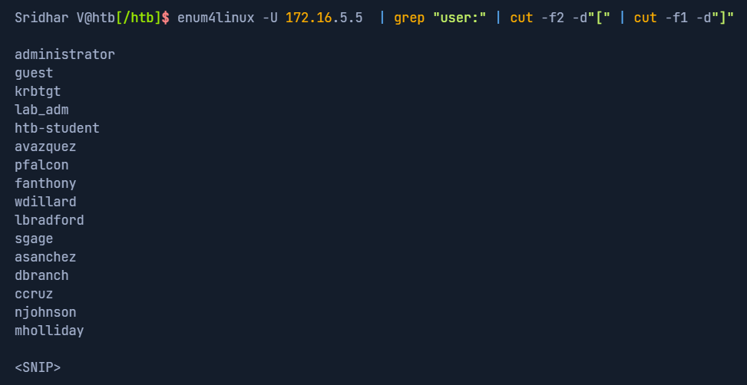
User Enumeration
Enum4linux
Enum4linux is a tool used in penetration testing to enumerate information from Windows systems via the Server Message Block (SMB) protocol. It's particularly focused on gathering information from Windows machines in a network, such as user accounts, share names, group memberships, policies, and other details that can be useful for understanding the network's structure and potential security vulnerabilities. This tool can be helpful for security professionals and system administrators in assessing the security posture of their networks and identifying areas that may need attention or improvement.
enum4linux -U 172.16.5.5 | grep "user:" | cut -f2 -d"[" | cut -f1 -d"]"

Slide 32
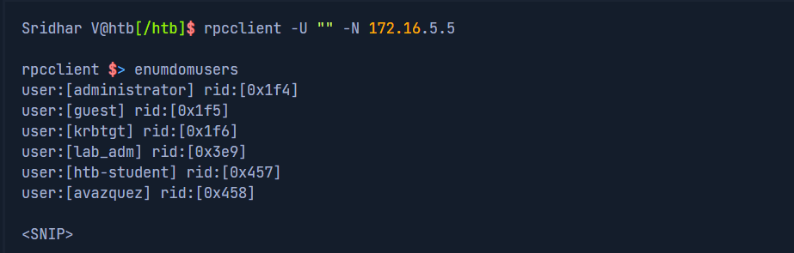
Rpcclient Null Session
An RPC null session refers to establishing a connection with a Windows system using the Remote Procedure Call protocol without providing any authentication credentials, enabling anonymous access. This can be done using tools like rpcclient. Null sessions can potentially expose sensitive information about the system if proper security configurations are not in place. However, accessing Windows systems with null sessions should be performed cautiously and only in authorized and controlled environments to avoid security risks.
rpcclient -U "" -N 172.16.5.5

Slide 33
Crackmapexec
CrackMapExec (CME) is a versatile post-exploitation tool utilized in penetration testing and red team engagements, particularly targeting Windows environments. It automates tasks such as network reconnaissance, lateral movement, privilege escalation, and credential theft through various protocols like SMB, LDAP, and WinRM. With its command-line interface, CME enables security professionals to identify vulnerabilities, enumerate shares, list users, extract password hashes, execute remote commands, and conduct pass-the-hash attacks, facilitating comprehensive assessments of Windows network security. However, its use should be restricted to authorized security assessments to prevent misuse and ensure ethical compliance.
Without Credentials
crackmapexec smb 172.16.5.5 --users
With credentials
sudo crackmapexec smb 172.16.5.5 -u username -p password --users

Slide 34
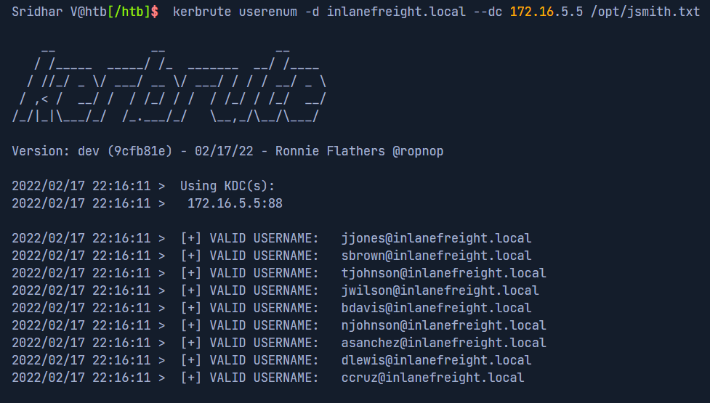
Kerbrute
Kerbrute is a powerful open-source tool primarily used for brute-forcing and enumerating Active Directory user accounts via the Kerberos protocol. Developed as part of the Rubeus project, Kerbrute is designed to test the security of Kerberos authentication within Windows environments. It works by attempting to authenticate users using a wordlist or by performing brute-force attacks to guess passwords, allowing security professionals to assess the strength of user credentials and potentially identify weak or compromised accounts. Kerbrute can also enumerate valid usernames and perform other reconnaissance tasks within Active Directory domains.
kerbrute userenum -d inlanefreight.local --dc 172.16.5.5 /opt/jsmith.txt

Slide 35
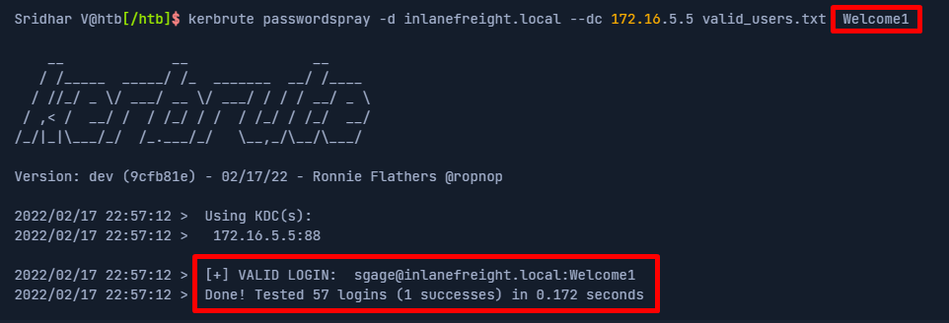
Password Spraying
Password spraying is a cyberattack technique used to gain unauthorized access to user accounts by attempting a few commonly used passwords against a large number of accounts. Unlike traditional brute-force attacks that try multiple passwords against a single account, password spraying involves trying a single or a small set of passwords against many accounts, often targeting weak or default passwords that are commonly used across organizations. This method reduces the risk of detection by avoiding numerous failed logins attempts on a single account and increases the likelihood of success by exploiting poor password practices. Password spraying attacks are typically carried out using automated tools and are a significant threat to organizations' security, emphasizing the importance of enforcing strong password policies and multi-factor authentication to mitigate the risk of unauthorized access.
kerbrute passwordspray -d inlanefreight.local --dc 172.16.5.5 valid_users.txt Welcome1

Slide 36
LLMNR Poisoning
LLMNR (Link-Local Multicast Name Resolution) poisoning is a cyberattack technique used to intercept and manipulate network traffic for malicious purposes. LLMNR is a protocol used in modern Windows operating systems to resolve the NetBIOS names of neighboring computers when DNS resolution fails. In LLMNR poisoning attacks, an attacker responds to LLMNR queries with false information, such as spoofed IP addresses or malicious payloads, tricking the target system into revealing sensitive information or redirecting network traffic to the attacker-controlled machine. This technique can be employed to conduct various attacks, including credential theft, man-in-the-middle attacks, and reconnaissance, posing a significant security risk to networks that rely on LLMNR for name resolution.
Let's walk through a quick example of the attack flow at a very high level:
A host attempts to connect to the print server at \\print01.inlanefreight.local, but accidentally types in \\printer01. inlanefreight.local.
The DNS server responds, stating that this host is unknown.
The host then broadcasts out to the entire local network asking if anyone knows the location of \\printer01. inlanefreight.local.
The attacker (us with Responder running) responds to the host stating that it is the \\printer01. inlanefreight.local that the host is looking for.
The host believes this reply and sends an authentication request to the attacker with a username and NTLMv2 password hash.
This hash can then be cracked offline or used in an SMB Relay attack if the right conditions exist.

Slide 37
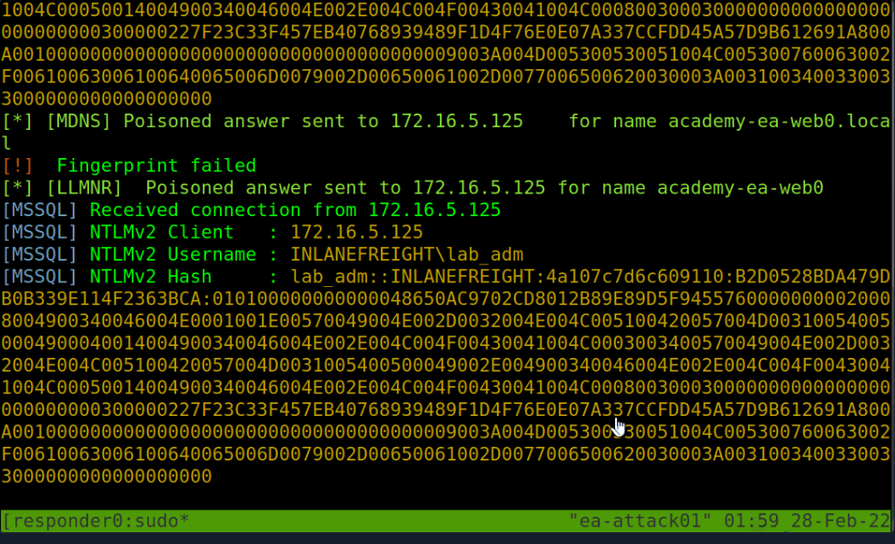
After we get the hash from the responder tool we need to crack the has to retrieve the password
sudo responder -I ens224

Slide 38
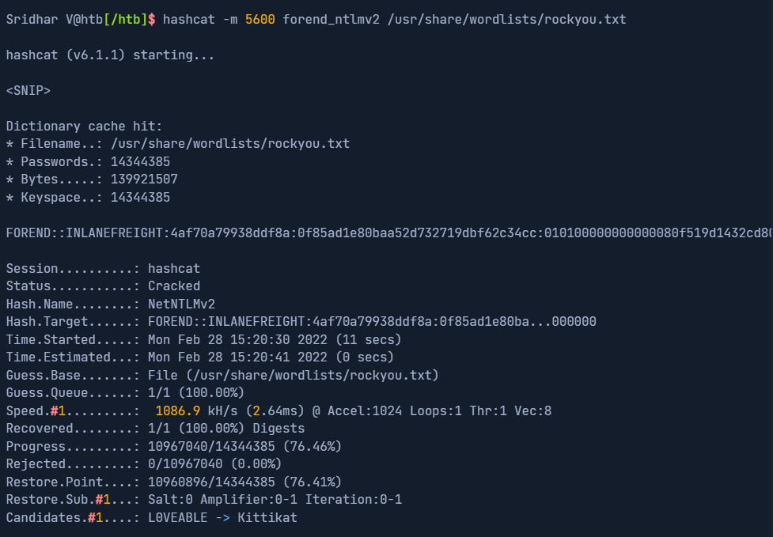
After getting the hash store it in a file and crack with hashcat to retrieve password.

Slide 39
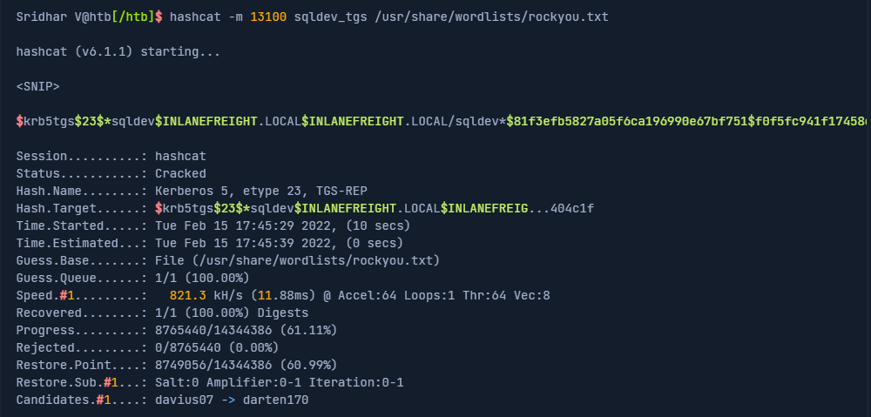
Kerberoasting
Kerberoasting is a lateral movement/privilege escalation technique in Active Directory environments. This attack targets Service Principal Names (SPN) accounts. SPNs are unique identifiers that Kerberos uses to map a service instance to a service account in whose context the service is running. Domain accounts are often used to run services to overcome the network authentication limitations of built-in accounts such as NT AUTHORITY\LOCAL SERVICE. Any domain user can request a Kerberos ticket for any service account in the same domain. This is also possible across forest trusts if authentication is permitted across the trust boundary. All you need to perform a Kerberoasting attack is an account's cleartext password (or NTLM hash), a shell in the context of a domain user account, or SYSTEM level access on a domain-joined host.
GetUserSPNs.py -dc-ip 172.16.5.5 INLANEFREIGHT.LOCAL/forend -request

Slide 40
Asreproasting
ASREPRoasting is a technique used in Active Directory environments to extract password hashes of user accounts that do not require pre-authentication. By sending a Kerberos AS-REQ request for authentication to the Key Distribution Center (KDC) without providing pre-authentication data, attackers can identify accounts vulnerable to ASREPRoasting. These accounts have their Kerberos pre-authentication disabled, allowing attackers to request their encrypted password hashes from the KDC. Attackers can then attempt to crack these hashes offline to retrieve plaintext passwords, potentially compromising the security of the network. ASREPRoasting highlights the importance of enforcing strong authentication policies and ensuring that all accounts require pre-authentication to mitigate this type of attack.

