Slide 1
OWASP Application Security Guide for Chief Information Security Officers (CISOs)
Marco Morana
Global Industry Committee
OWASP Foundation
Chapter Meeting
November 8th 2012 London UK
Notes:
I think the presentation would be perfect for this audience, we normally have a very senior audience (CISO, Head of Information Security, Director of Information Security, etc) who appreciate a presentation that makes them think, confirms that they are going down a similar road to others, or even to reconsider what they are currently doing!
At all of the events we have a mixture of technical, operational and strategic presentations, which hopefully provides the delegates who are involved in different job roles an interesting mixture of topics and areas. I believe that your presentation will fit perfectly into the strategic area. Here is a link to the previous agenda from the last e-Crime Mid Year meeting in London. I think that some of the topic areas will have evolved, but hopefully it will give you a better picture of the different types of presentation that take place throughout the day and the variety of topics covered. http://www.e-crimecongress.org/forum/website.asp?page=2011agenda
I have also sat with my manager, Jon Hawes, today and talked through the amends to the presentation bullet points. Jon has suggested the changes below which I hope captures some of the content that the presentation will cover. Please feel free to change these as you wish, as they are only suggestions! It would be great to hear your thoughts.
Adapting to evolving cyber attack scenarios: a focus on online banking and e-Commerce threats
- New threats and attacks: how are the types and level of impact that businesses must prepare for changing, and what are the implications for security stakeholders?
- How can existing measures designed to prevent and detect attacks be improved to mitigate loss and guard against potential business disruption?
- Structuring application security controls to reduce risk and maximise the value of software security engineering, threat modelling and security testing
- Preparing for what the future holds as the cyber threat landscape continues to change: tools and techniques that can support enterprise security strategy
Best wishes, and if you do have any questions please don't hesitate to give me a call,

Slide 2
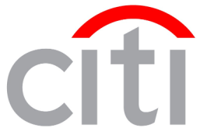
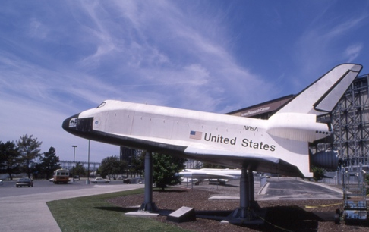
About myself and what brought me here
Notes:
Today I live in London right on the river Thames, actually the view of the left top corner is a picture from my apartment. So here we go this patchwork describes my career journey that started by graduating from Univ of Padova 25 years ago. You might recognize some of the companies here, some are old brands some are unknown companies (like the one I founded ☺ Some of the pics shows the cities I lived the city where Galileo used to teach, Padova, Torino, Berkeley, Palo Alto where I worked and Atlanta, Rome, Cincinnati (where I still have my home) and London.
Point want to make here, careers are not straight lines, just make sure you follow your passion in life, OWASP is an organization I am very passionate about.

Slide 3
Why an OWASP Guide For CISOs?
Notes:
First question probably someone will ask

Slide 4
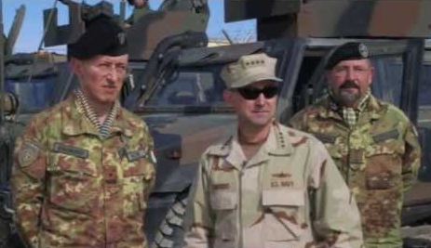
Notes:
The main points to cover in this slide is to answer the question;
Today CISOs are like for 4 start military generals
As generals, they are responsible for
Set the strategy goals and the governance to pursuit the goals
Make informed risk decisions on the ‘battle ground’ on how mitigate risks from threat agents based upon situational awareness, threat intelligence
Decide on which countermeasures to invest to mitigate the risks and ‘win the battle against the threat agents”
3) As 4 start generals, they need guidance, that is a trusted advisor that help them making risk decisions and decide in which countermeasures to invest. For a general his advisor might be a trusted officer, for CISO we want this advisor to be OWASP and the guide the document that helps the CISOs in executing his roles and responsibilities in application security
Other points:
The goal of this guide is aligned to OWASP mission goals that are “to get application security visible so that individuals and organizations can make informed decisions about true software risks”. Specifically, the intent of this guide is to help CISOs (Chief Information Security Officers) to make informed decisions on how to mitigate the risks of insecure web applications and web application software.
Think about the CISO like a for star general that ought to make informed risk decisions on how to mitigate risk, to managing of application security risks, one of the roles and responsibilities of CISOs is to direct application security programs that includes developing and implementing security policies, standards and guidelines, work with audit and legal counsel to establish compliance with regulatory compliance requirements and define and implement an ongoing application security program which will identify the critical web application assets, assess threats and vulnerabilities of these assets and recommend application security measures. Specifically for the recommendation of application security measures, it is important for the CISO to make informed decisions on how to mitigate application security risks and decide in which application security measures to invest. This aim of this guide is to help the CISO in making these decisions. For example, by providing CISOs with risk and cost criteria for deciding which application vulnerabilities to prioritize for remediation and which countermeasures to implement to protect web applications from new threats and attacks

Slide 5
What CISO care for?

Slide 6
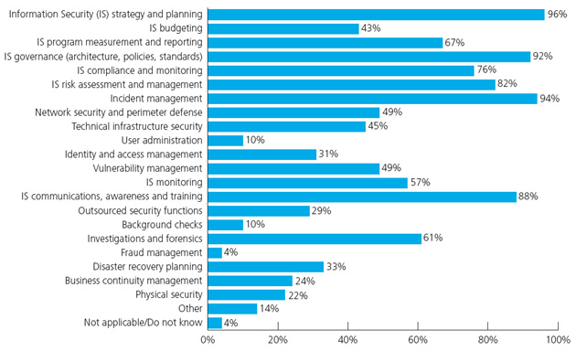
CISOs Surveys
Sources:
Deloitte and the National Association of State CIOs (NASCIO) are sharing the results of a joint Cyber Security Survey, finding that State Chief Information Security Officers (CISOs) in 2010
Notes:
The main point of this slide is to emphasize the importance to understand what CISO care of so to see how OWASP can help. This slide shows a survey to try to answer the activities that are in scope for CISOs functions or say responsability
The main point of this slide is that a good guide that target a specific role of security in the organization such as the CISO need to be focused on what are the activities that the CISO spends more time of. Based upon this survey from deilotte of two years ago for example, it is clear that within the main priorities for CISOs activities we have above the red bar, the one in red:
Strategy for information security and planning for IS activities
Governance that is set the policies, standards and processes that need to be followed and the organizational structure (people, process, technology) that’s supports it
Incident management that is how to manage security incidents
Awareness and training
IS Risk assessment and management
According to this survery on the average activities that are in scope for CISO at least close of 50% of them are the one in orange
Permeter security
Technical infrastructure security
IS monitoring
Vulnerability management
Investigations and forensics
And then you have everthing below and in between
Deloitte and the National Association of State CIOs (NASCIO) are sharing the results of a joint Cyber Security Survey, finding that State Chief Information Security Officers (CISOs) in 2010
The Top Three Priorities for CISOs:
are IS strategy and planning 96%
Incident management at 94%
Is governance (architecture, policies and standards) at 92%
IS communications and awareness at 88%
IS risk assessment and management at top 5 at 82%
IS compliance and monitoring at 76%
IS program measurements and reporting at 67%
Investigation and forensics at 61%
IS monitoring at 57%
vulnerability management at 49% with network security and perimeter
Technical ifrastructure security 45%
Disastery recopvery 33%
Identity and access management 31%
Outsorce security 29%
Business continuity 24%
Phiysical security 22%
Other 14%
Background checks 10%
Fraud management 4%

Slide 7
What CISOs will care of?

Slide 8
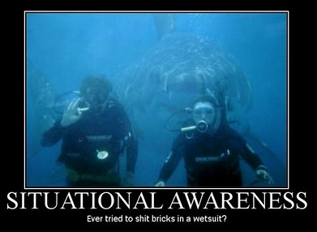
Notes:
The main point of the slide is we have seen a focus on IS strategy and planning as number 1 priority, but is this really the right priority as a scuba diver that is
FOCUSING ON THE REPORTER RATHER THAN ON THE THREAT COMING FROM BEHIND… perhaps CISOs need to be more situational aware? And sorry yes I tried to shit a brick in a wetsuit, it is not a nice feeeling (:

Slide 9
The Evolution of the Threat Agents
Notes:
The main point of this slide, quickly is that one of the things CISO should care of is the escalation of threats, and the fact that have to confront not just comliance risks but the risk of
Script kiddies and hacktivists targeting the site with ddos, fraudsters and cybercriminals going after credit card data and the money as well as country sponsoored cyber-spies and threat agents
So perhaps the focus should be how the CISO can adapt to these threats quick enough not to be caught and loose his job
Ten years ago:
Threat agents: script kiddies
Motives: becoming famous
Severity: occasional denial of service
Today:
Threat agents: cybercriminals and hacktivists
Motives: financial and political
Severity: identity theft, DDOS, online fraud

Slide 10
Data Breach Incidents: 2011-2012 Statistics
Threats Agents: Majority are hacking and malware
Targets: 54% of incidents target web applications
Likelihood: 90% of organizations had at least one data breach over the period of 12 months
Attacks-Vulnerabilities: SQL injection reigning as the top attack technique, 51% of all vulnerabilities are XSS
Data Breach Impact: Majority are data lost are user’s credentials, emails and personal identifiable information
Business Breach Impact: The average cost of a data record breached is estimated as $ 222 per record
Incident Response: Majority of incidents is discovered after weeks/months from the time of initial data compromise
Sources: OSF, DataLossDb.org
Ponemon Institute and Symantec, Research March 2012
Verizon’s Investigative data Breach Report 2012
IBM X-Force 2012 Mid Year Trend & Risk Report
Notes:
The main point of this slide is to be aware of the facts and translate the facts in risks, here is an example of data sruvery that allow CISOs to make a risk assessment for data breach incidents based upon available data.

Slide 11
How a CISO Guide Can Help?

Slide 12
OWASP Guide for CISOs
Criteria for Application Security Investments
Legal and Compliance Criteria
Risk Management Criteria
Selection of Application Security Measures
Vulnerabilities with the Most Business Impact
Target Threats with Countermeasures
Mitigate the Risks of New Technologies
Selection of Application Security Processes
Addressing CISO Role & Responsibilities
Targeting Software Security Activities and S-SDLC Processes
How to choose the right projects and tools from OWASP
Metrics for managing application security governance, compliance and risks
Application Security Process Metrics
Application Security Risk Metrics
Security in SDLC Issue Management Metrics
12
Notes:
One of the main question for CISO is where I should out the focus on that is where I should invest to mitigate the risks to web application.
This slide answer specifically this question such as by guiding the CISO in the following needs:
Set risk miitigation and Appsec security strategy, set the governance and compliance
Select which measures to put the most focus on, which vulnerabilites to focus upon and measures to mitigate risk
Which application security processes such as S-SDLC and which OWASP tools and projects based upon CISOs responsabiltiies
How to make the risk using risk management metrics but also how to decide where is more efficient to invest

Slide 13
Thank You For Listening
Browse for OWASP Guide for CISOs
Email Project Leader & GIC
Participate to the CISO Survey!!!
Please leave your business card !

Slide 14
Q
&
Q U E S T I O N S
A N S W E R S

Slide 15
Appendix: Mapping CISO’s Responsibilities
CISO RESPONABILITY | DOMAIN | CURRENT OWASP PROJECTS | OWASP CISO GUIDE
Develop and implement policies, standards and guidelines for application security | Standards & Policies | Development Guide - Policy Frameworks CLASP - Identify Global Security Policy SAMM - Policy & Compliance, Code Review- Code Reviews and Compliance, Cloud-10 Regulatory Compliance
Develop implement and manage application security governance processes | Governance | SAMM - Governance
Develop and implement software security development and security testing processes | Security Engineering Processes | Development Guide -All Code Review Guide- All, Secure Code Practices Guide-All, Testing Guide-All, CLASP-All, SAMM-All, Security Tools for Developers-All Application Security Standards-All
Develop, articulate and implement risk management strategy for applications | Risk Strategy | SAMM - Strategy & Metrics
Work with executive management, business managers and internal audit and legal counsel to define application security requirements that can be verified and audited. | Audit & Compliance | Application Security Verification Standard-All, CLASP-Document Security-Relevant Requirements, SAMM-Security requirements, Testing Guide-Security Requirements Test Derivation, Legal-Secure Software Contract Annex
Measure and monitor security and risks of web application assets within the organziation | Risk Metrics & Monitoring | Application Security Metrics Project, CLASP-Define and monitor metrics
Define, identify and assess the inherent security of critical web application assets, assess the threats, vulnerabilities, business impacts and recommend countermeasures/corrective actions | Risk Analysis & Management | OWASP Top Ten Risks, Testing Guide-Threat Risk Modeling Development Guide-Threat Risk Modeling, Code Review Guide-Application Threat Modeling Testing Guide-Threat Risk Modeling
Assess procurement of new web application processes, services, technologies and testing tools | Procurement | Legal project Tools project Contract Annex
Oversees the training on application securuty for information security and web application development teams | Security Training | Education Project Training Modules/Conference Videos Application Security FAQ CLASP-Institute security awareness program
Develop, articulate and implement continuity planning/disaster recovery | Business Continuity/ Disaster Recovery | Cloud- Business Continuity and Resiliency
Investigate and analyze suspected security breaches and recommend corrective actions | Incident Response | .NET Incident Response, CLASP-Manage Security Issue Disclosure Process

