Slide 1
PCI SSC
The view from the Bridge
Jeremy King
International Director
PCI SSC

Slide 2
Ok more the view of the bridge!

Slide 3
Not everything in life ends up as you originally planned!
However 640 years later
It is a tower
It is still standing
People can climb the tower
It contains Bells
The bells ring
It is still leaning

Slide 4
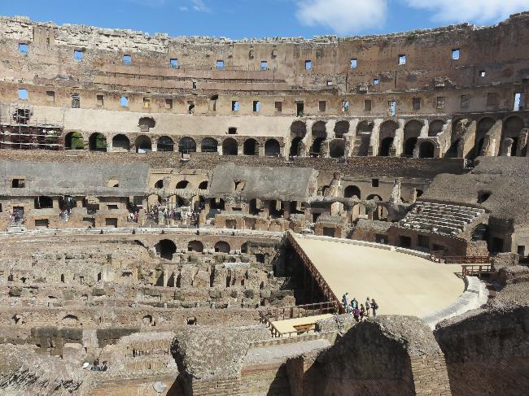
But if you build it well it can last

Slide 5
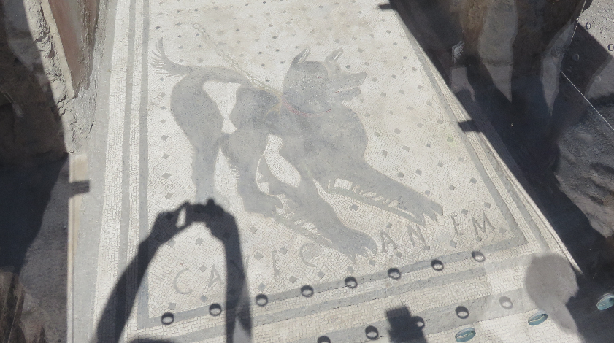
And remember we were not the first
Cavec An Em
Beware of the dog!!

Slide 6
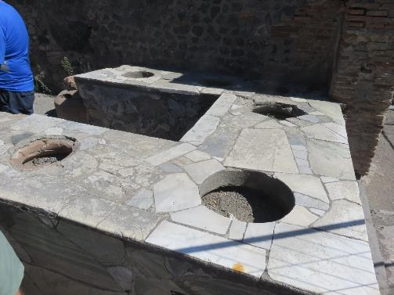
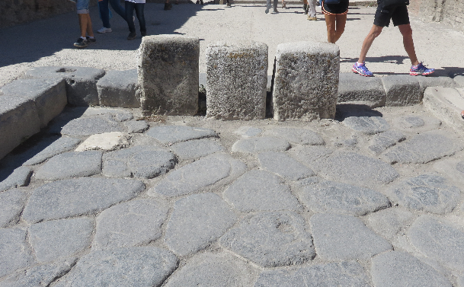
For fast food or bollards

Slide 7
But you cannot always defend against every eventuality!

Slide 8
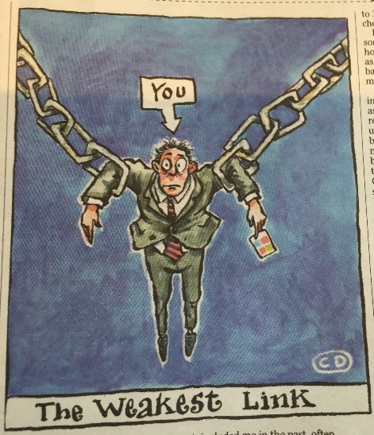
So where does this all leave us
People
Process
Technology
And a bit of luck

Slide 9
Why?
Because we ignore what logic tells us is not right

Slide 10
Why?
Because even when logic tells you it is wrong….

Slide 11
Why?
Because sometimes it is just plain wrong

Slide 12
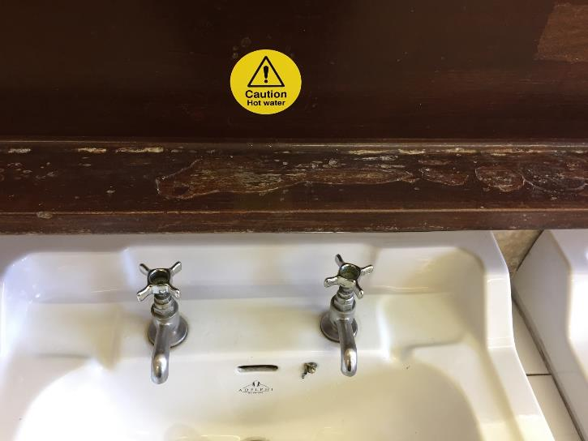
Sometimes the advice is clear but not the choice

Slide 13
But we have champions of security

Slide 14
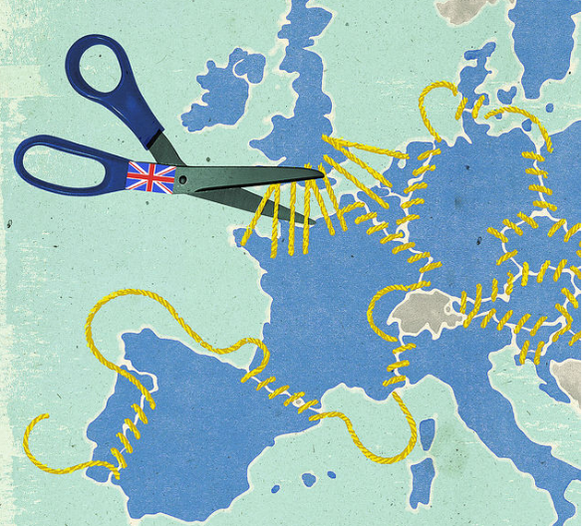
Brexit and all of that
How will Brexit impact new EU regulation?
It won’t

Slide 15
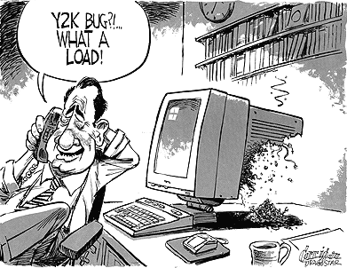
2018 and all that
The clock is ticking
This is no Y2K bug, or maybe it is?
Notes:
What is so important about 2018. Well all of the new EU regulation comes into force in 2018, that means GDPR, PSD2 and EBA Securing Internet Payments. IFR already is in place

Slide 16
European General Data Protection Regulation European Payment Services Directive 2 EBA Securing Internet Payments European Interchange Fee Regulation
This is what is coming;

Slide 17
Lets look at some key aspects: Security
EU GDPR : Personal data must be processed in a manner that ensures appropriate security of the personal data, including protection against unauthorised or unlawful processing and against accidental loss, destruction or damage, using appropriate technical or organisational measures
EBA Securing Internet Payments: All data used to identify and authenticate customers should be appropriately secured
EBA Securing Internet Payments: Acquirers should contractually require merchants to ensure security measures in their IT infrastructure
EU PSD 2: All payment services offered electronically shall be carried out in a secure manner, adopting technologies able to guarantee a safe authentication of the user and to reduce, to the maximum extent possible, the risk of fraud

Slide 18
Fines and Penalties
In the case of a personal data breach, the controller shall without undue delay and, where feasible, not later than 72 hours after having become aware of it
Administrative fines shall, depending on the circumstances of each individual case, be imposed
Infringements shall be subject to administrative fines up to €10M or in the case of an undertaking, up to 2% of the total worldwide annual turnover of the preceding financial year, whichever is higher
Infringements shall be subject to administrative fines up to €20M or in the case of an undertaking, up to 4% of the total worldwide annual turnover of the preceding financial year, whichever is higher for articles 5,6,7,& 9

Slide 19
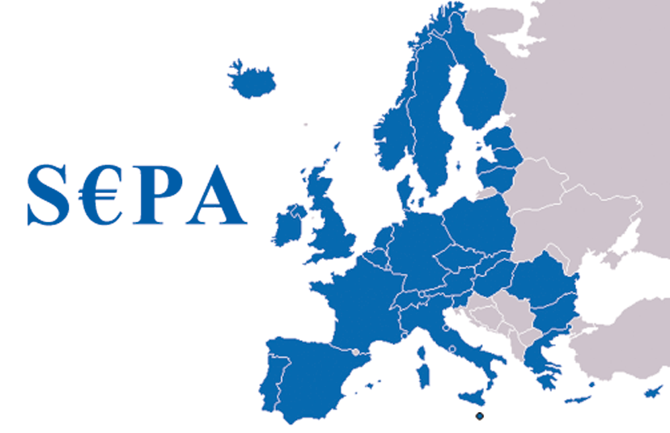
PCI Standards provide the best means of meeting these new European Regulations
Data Protection Directive
PSD2
Securing Internet
Payments

Slide 20
Changes in PCI DSS 3.2

Slide 21
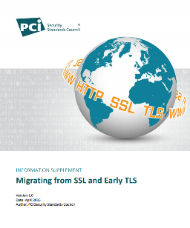
SSL to TLS Background and Timeline
SSL/TLS used as example in DSS v3 and earlier
Example of ‘strong cryptography’
Example of additional security for insecure services
Marketplace feedback
Technical issues - relatively easy
Business issues - complex
April 2014 NIST –SSL&TLS 1.0 Unsafe
PCI SSC Seeks Industry Input
April 2015
PCI SSC Issues PCI DSS v3.1 and Guidance
Marketplace Feedback
December 2015 PCI SSC Issues New Migration Dates

Slide 22
SSL and Early TLS: New Migration Dates
SSL & early TLS not considered strong cryptography & not allowed as security control after 30 June 2018
All processing and third party entities – including Acquirers, Payment Processors, Gateways and Service Providers must provide a TLS 1.1 or greater service offering by 30 June 2016.
All entities must cutover to a secure version of TLS (as defined by NIST) by June 2018.
Consistent with the existing language in PCI DSS v3.1, all new implementations must be enabled with TLS 1.1 or greater (TLS 1.2 recommended).
POI terminals (and the SSL/TLS termination points to which they connect) that can be verified as not being susceptible to all known exploits for SSL and early TLS, can continue to use SSL/early TLS beyond June 2018 consistent with the current exception.

Slide 23
Multi-factor Authentication
Terminology: “two-factor” replaced with “multi-factor”
More accurate terminology
Two or more factors may be used
Does not change intent of original requirement
Still can’t use one factor twice
Already required for all remote access to the CDE
Now also required for personnel with administrative
access into the CDE

Slide 24
New Requirements for Service Providers
New requirements adapted from DESV:
Documentation of cryptographic architecture
Detect and respond to failures in critical security controls
More frequent penetration testing on segmentation controls
Maintain a formal PCI DSS compliance program
Periodically confirm personnel are following security policies and procedures
All new requirements future-dated to 1st February 2018

Slide 25
What this does not mean
Service Providers do not have to adopt and migrate to TLS1.1 or greater now
Service Providers have the same timeline as everyone else to migrate – 30th June 2018
Service Providers ARE required to provide TLS1.1 or greater as an option to support Merchants who have migrated

Slide 26
P2PE V2

Slide 27
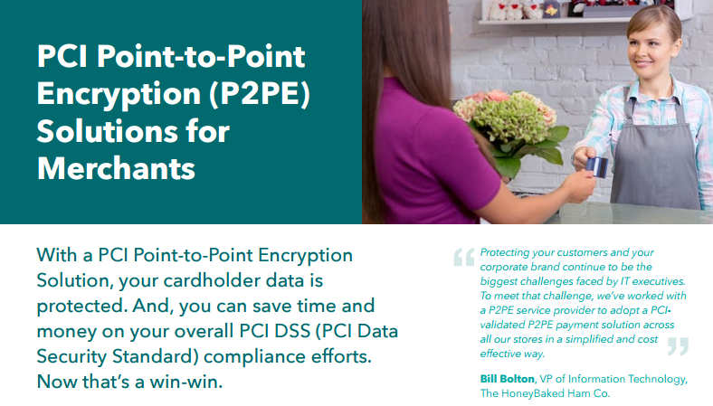
PCI Point-to-Point Encryption (P2PE) v2
Notes:
Let’s start with new updates to PCI DSS – Point to Point Encryption Version 2 is published and assessments can and have begun

Slide 28
Why P2PE?
Protect cardholder data throughout the transaction cycle
Mgmt.
Sales and Marketing
Stock Control
3rd party suppliers
Point of Interaction
In Store Server
Data center
The Internet
Merchant
3rd Party Processor
Acquiring Bank
Moto
Ecommerce
Notes:
Specifically, PCI Standards focus on protecting the payment transaction so that anywhere the payment information is accepted, processed, transmitted and stored it’s done so in a secure way that doesn’t put the consumer at risk.
It does this with a layered approach that includes controls to address people, process and technology.

Slide 29
Software Security Task Force
In September 2016, PCI SSC convened a Software Security Task Force (SSTF) to evaluate existing Council programs and define a strategy for how to better support modern software development techniques and technologies
Comprised of software security experts both within and outside of the payments industry representing 30+ unique organizations (see Appendix A)
Intent is to define a payment industry-specific validation model and requirements, and then supplement them with existing frameworks (such as OWASP ASVS) where appropriate

Slide 30
Task Force Representation

Slide 31
Requirements Architecture: Components
Foundational Principles
Proposed framework is based on the validation of a set of foundational principles
Security Objectives
Within each of the foundational principles are a series of security objectives
Security objectives define the desired general capabilities and outcomes that the software application and/or the software vendor must demonstrate
Required Security Defenses
Under each security objective are a set of additional required security defenses; can be platform-/function-agnostic or specific
Security defenses define additional capabilities and/or outcomes that must be demonstrated by the software and/or software vendor
Modules
Platform- or function-specific requirements are grouped together into modules
Modules are created as needed to address new technologies or functional use-cases

Slide 32
Three-part Validation Model
Full Software Application Review
Detailed review of software architecture, code, and components by third-party labs/assessors to validate conformance with applicable foundational principles and their underlying objectives and required defenses
Software Development Life Cycle Review
Detailed review of software vendor development processes by third-party labs/assessors in order to validate conformance with applicable foundational principles and their underlying objectives and required activities
Software ‘Delta’ Reviews
Interim “check-ups” conducted by software vendor and performed in cooperation with PCI SSC and/or third-party labs/assessors to validate continued conformance with foundational principles.

Slide 33
PCI DSS is the Foundation
Keep the bad guys out
Set up your systems properly
If you must have data then protect it
If you must send data then encrypt it
Protect yourself against malware and other attacks
Build your software properly and securely
Keep access to the card data to a minimum
Make sure people are who they say they are
Physical security is just as important
Track who goes where and what they do
Test and check everything is working correctly
Make sure everyone knows what is required
Notes:
Cost of global cybercrime = $465 billion US annually - Allianz
The fact that so many Brazilians are victims of cybercrime is not entirely surprising. After all, 58 percent of the country’s 200 million citizens are connected to the Internet. This compares with 49 percent for both China and South Africa and 18 percent of Indians. At least 45 percent of all banking transactions in Brazil are digital. Brazil, with 130 machines per 100,000 adults, has a greater density of ATMs than the United Kingdom (127 per 100,000), France (109 per 100,000), or Germany (116 per 100,000), according to World Bank data. https://www.foreignaffairs.com/articles/south-america/2015-09-17/brazils-cybercrime-problem
95% - ABECS

Slide 34
Thank You!

